Slide 1
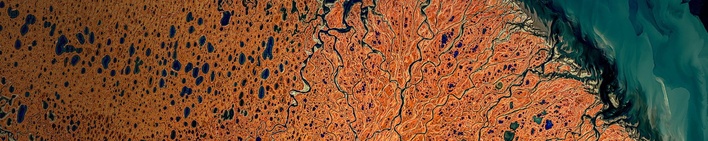
deck.gl, GeoArrow, and Lonboard
Performant, interoperable rendering of large data
Kyle Barron
Cloud Engineer @ Development Seed

Slide 2
Lonboard
Implementation Details
Ecosystem Motivations
Future work

Slide 3
Simpler, faster rendering of large analytical vector datasets (from Python)

Slide 4
…why not existing Python libraries?

Slide 5
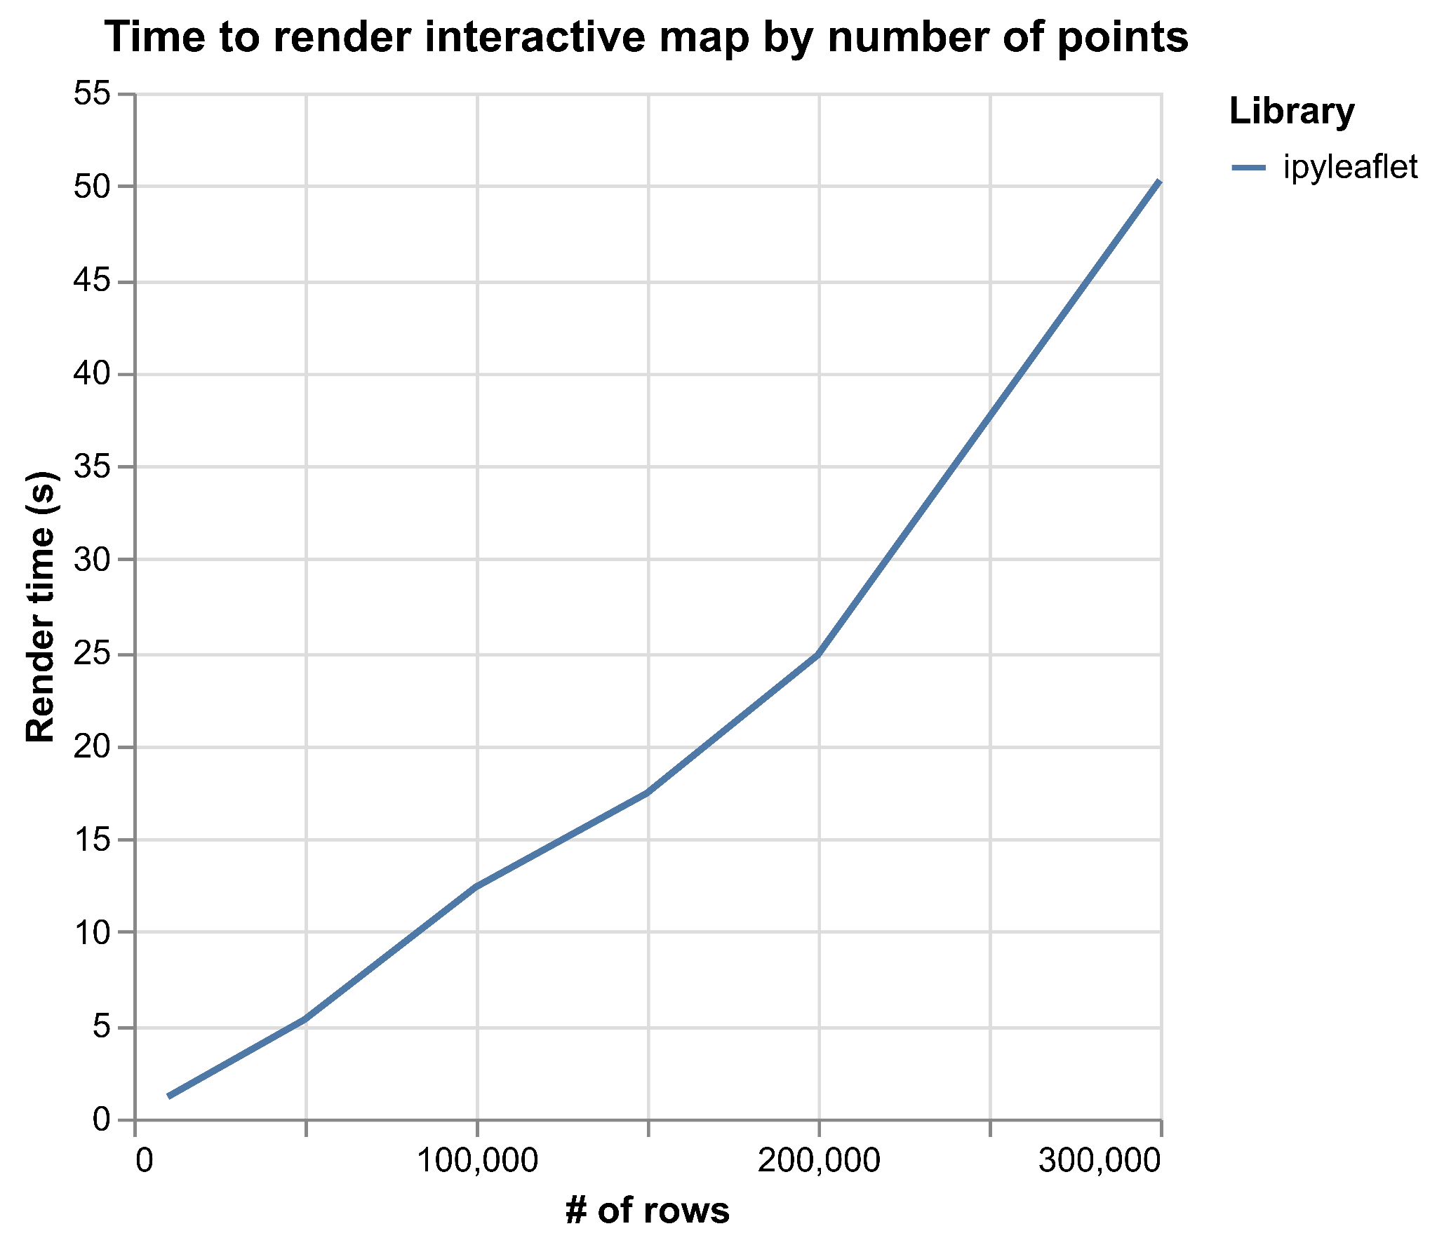
ipyleaflet?
Notes:
Failed at 400,000 points

Slide 6
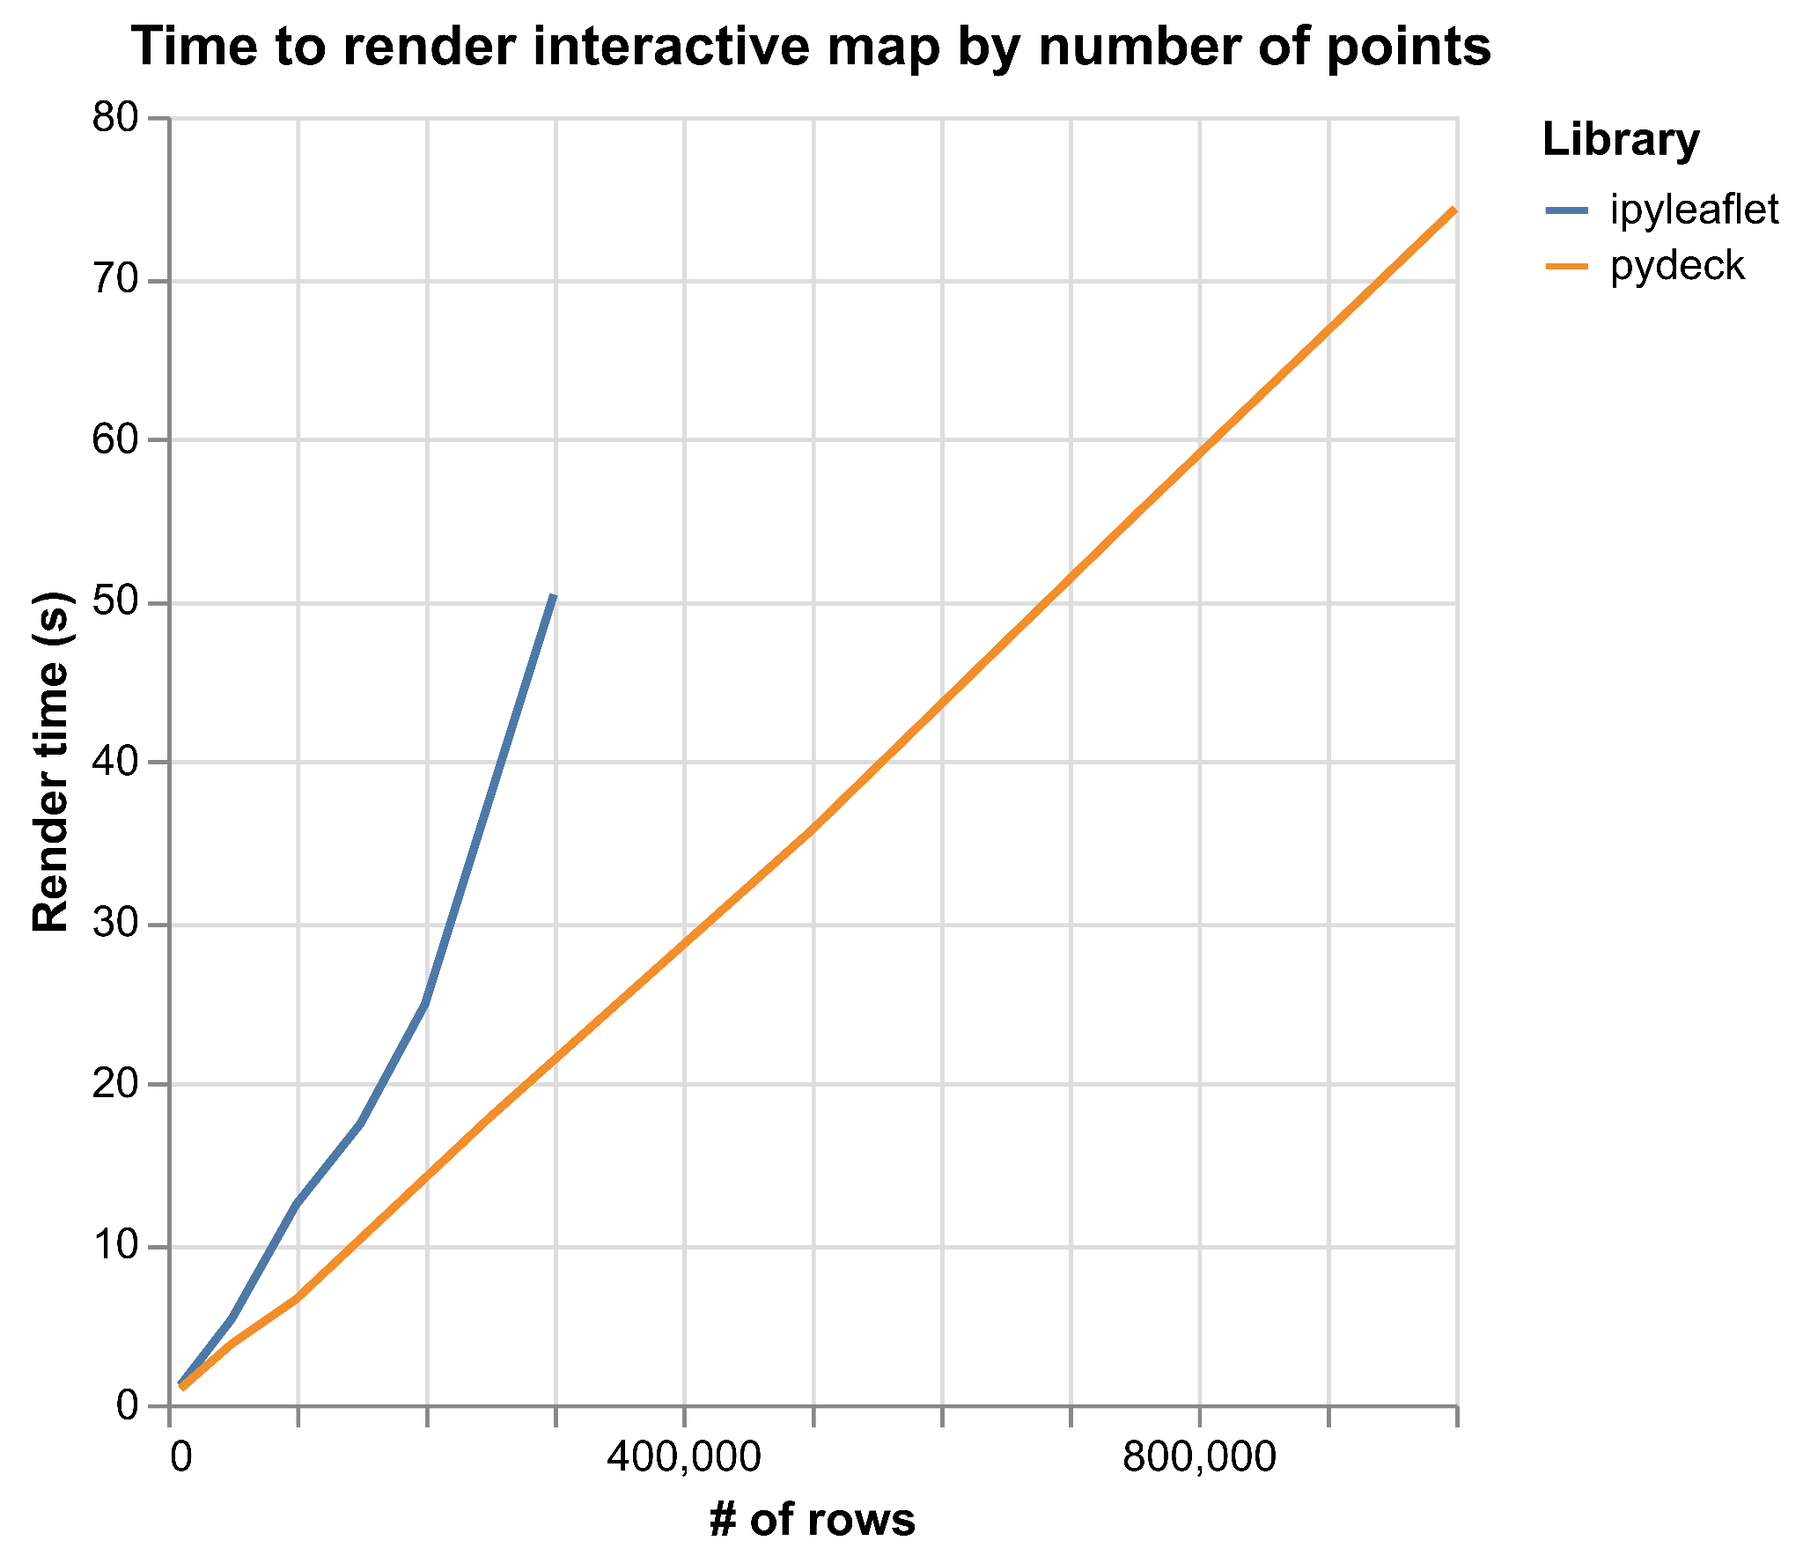
pydeck?
Notes:
Powered by deck.gl on the GPU
Failed at 1.2 million points (after 90 seconds)

Slide 7
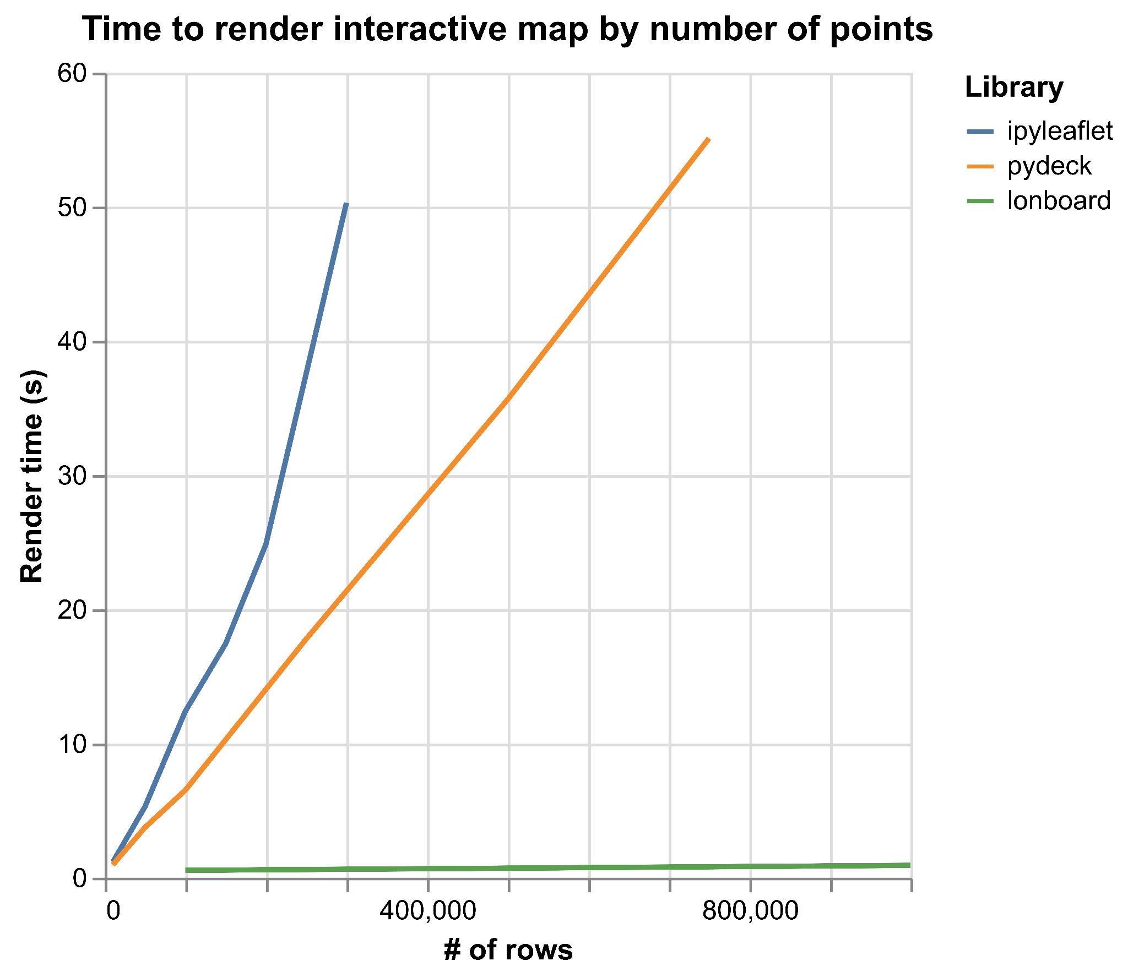
lonboard!
Notes:
Failed at 1.2 million points (after 90 seconds)

Slide 8
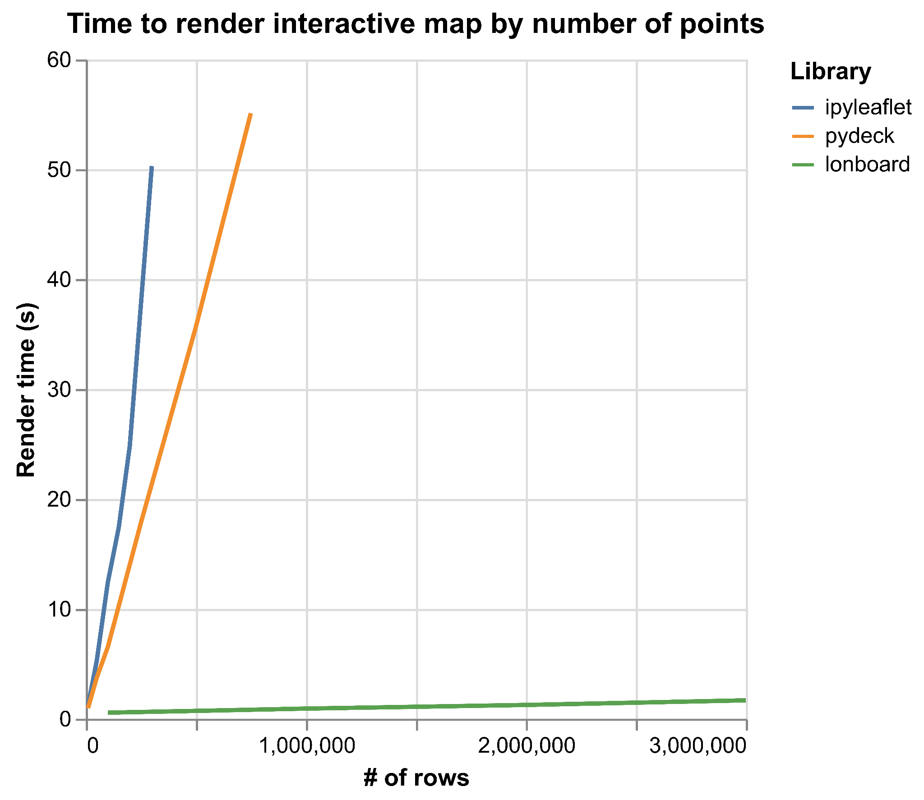
lonboard!
Notes:
Failed at 1.2 million points (after 90 seconds)

Slide 9
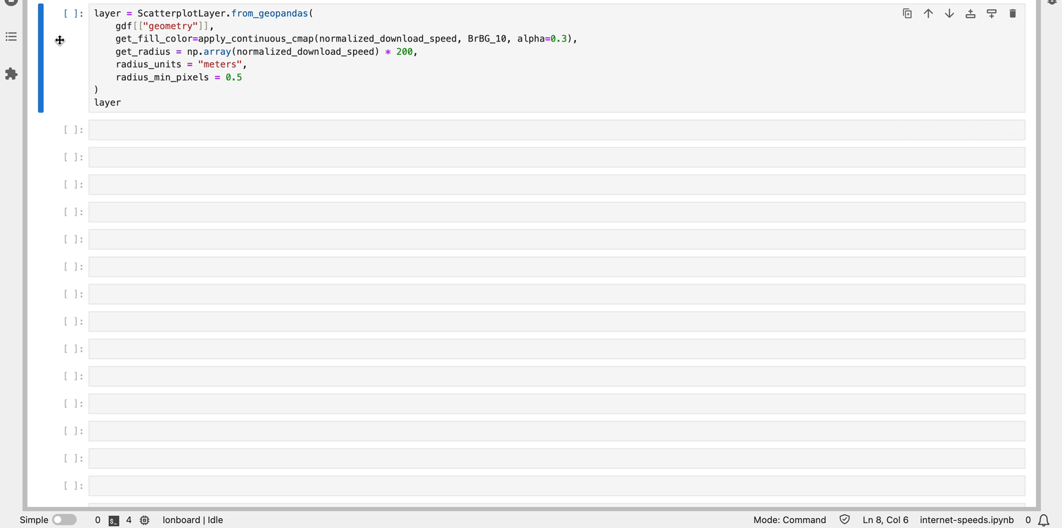
Lonboard: 3 million points in 2.5 seconds

Slide 10
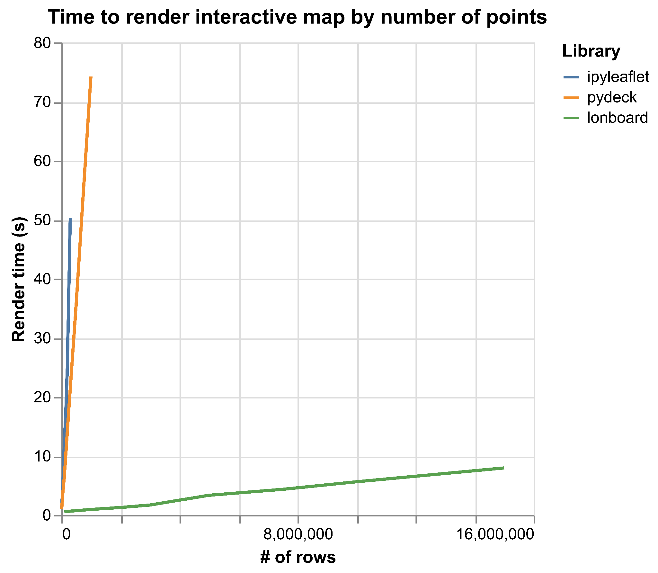
lonboard!
Notes:
Rendered 10 million points in the time it took ipyleaflet to render 50,000 points
Rendered 15 million points

Slide 11
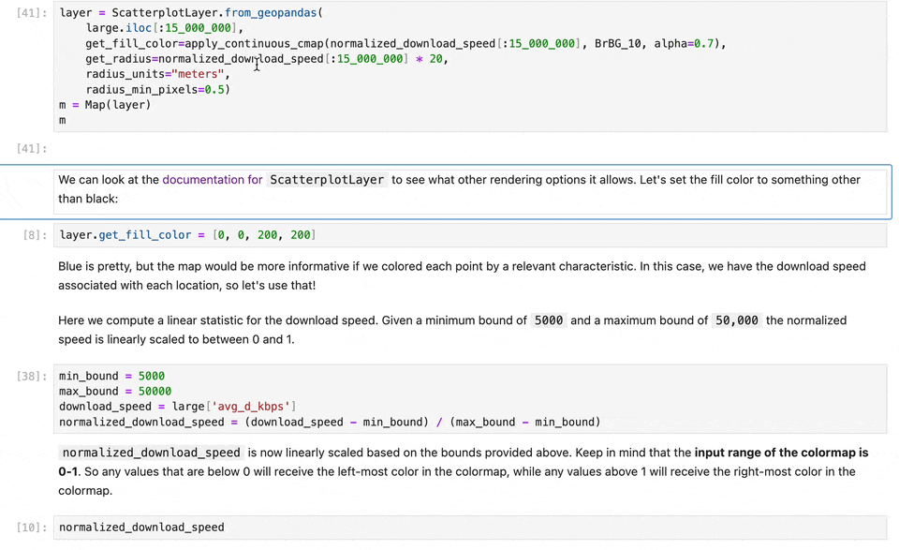
Laggy, but functional at 15M points

Slide 12
How is it so fast?

Slide 13
Data rendering on the web
Three parts of vector web maps
Load data to the browser
Manage data in memory
Render to screen
Notes:
A crucial part of this talk is JavaScript and the browser, because if you want to have interactivity, you need to use the browser.

Slide 14
Data rendering on the web
Three parts of vector web maps (slow)
Load data to the browser
Manage data in memory
Render to screen
GeoJSON
Massive file size
Very slow to read and write
No partial reads
GeoJSON-like JavaScript objects
Memory overhead
Can’t be shared with web worker or WebAssembly
High garbage collector overhead (many small JavaScript array objects)
Leaflet
Slow to iterate over input features and render to HTML canvas element
Notes:
Each part can be bottleneck

Slide 15
Binary data pipelines are fast
Three parts of vector web maps (fast)
Load data to the browser
Manage data in memory
Render to screen
GeoParquet
Fastest way to move data
Efficient compression
Remote partial reads (cloud-native)
Spatial/column selection
Very fast to read and write
GeoArrow
Most efficient way to represent geospatial DataFrames
Binary buffers store entire column’s data
No serialization to share with web worker or WebAssembly
No garbage collector overhead
deck.gl
Fastest analytical map rendering on the web
Copy directly from GeoArrow memory to the GPU
Instanced (vectorized) draw calls
Notes:
Enabled by both server & client advancements
Each part minimizes bottleneck

Slide 16
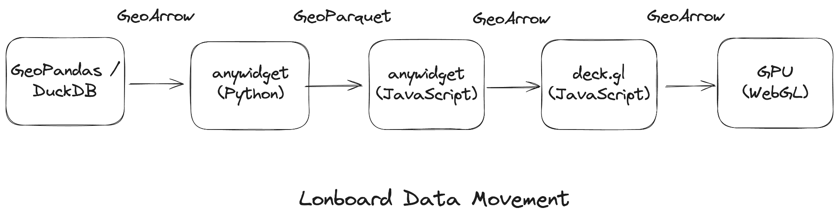
End-to-end binary data pipeline
Notes:
GPU doesn’t matter if you’re CPU-limited
GeoArrow & GeoParquet throughout the data pipeline.
Python: GeoPandas to GeoArrow to Parquet.
Transfer compressed binary buffers to the Browser.
JavaScript: Decode Parquet to GeoArrow.
deck.gl: Pass GeoArrow buffers to the GPU.

Slide 17
High-level API
Integrates with existing libraries
GeoPandas GeoDataFrame, GeoSeries
Shapely array, scalar
DuckDB Spatial query
GDAL (pyogrio)
Ibis (in progress)
Any GeoArrow Python object

Slide 18
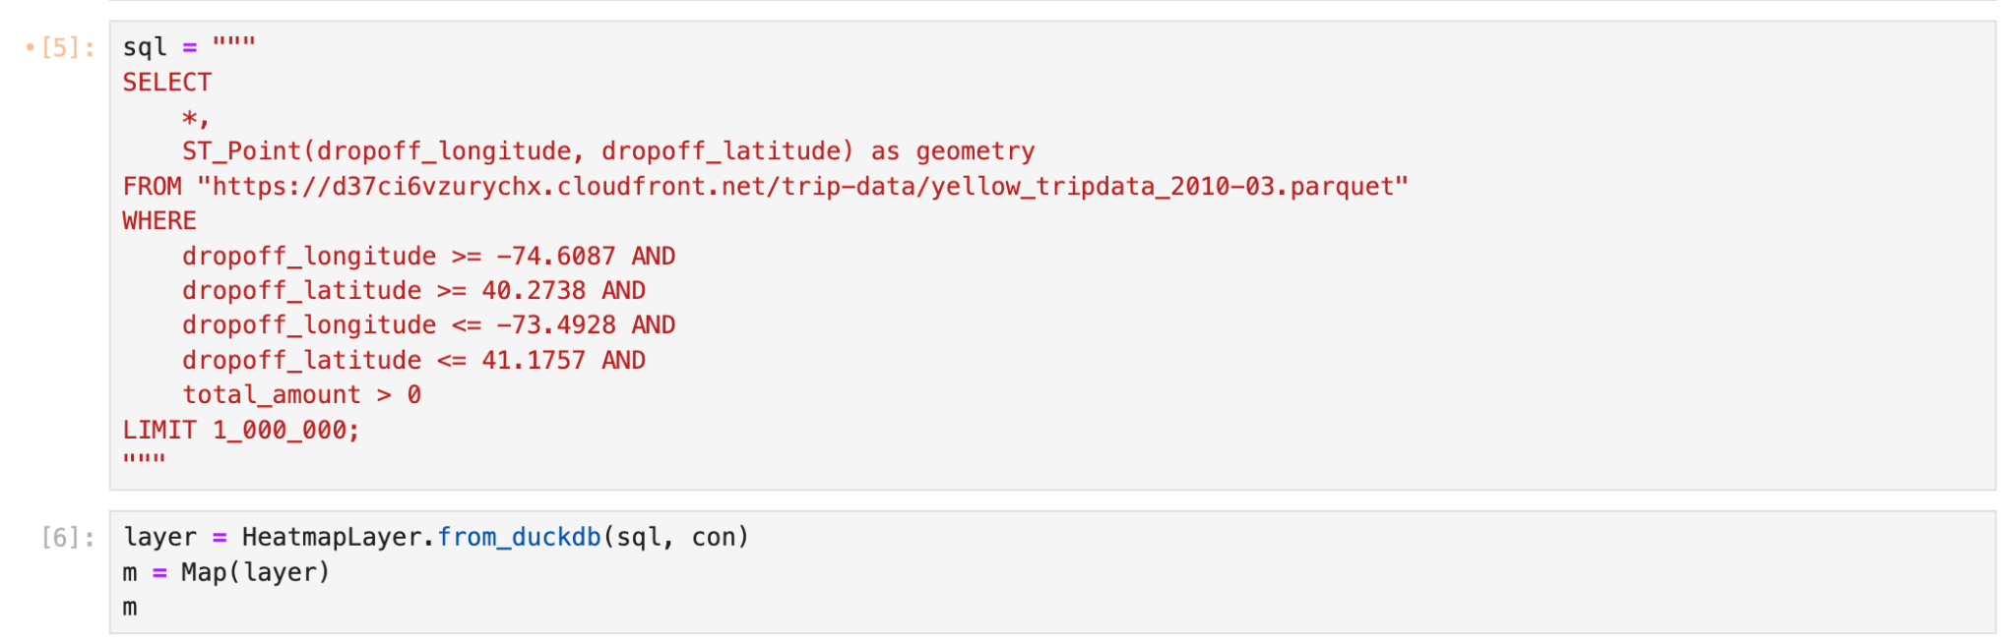
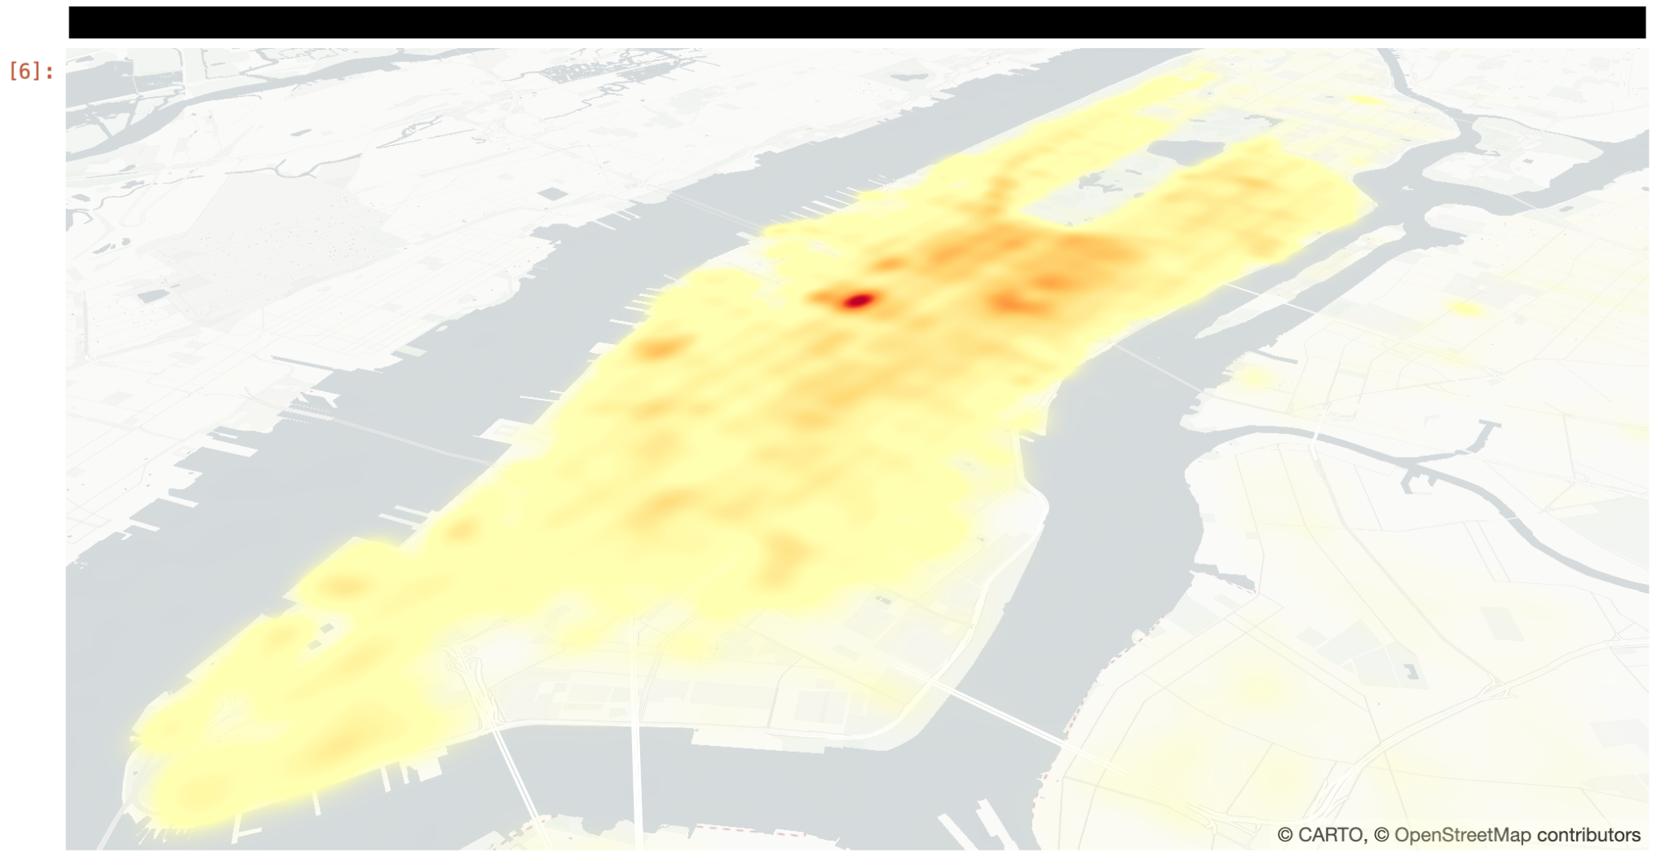
High-level API
DuckDB Integration
Pass query into from_duckdb

Slide 19
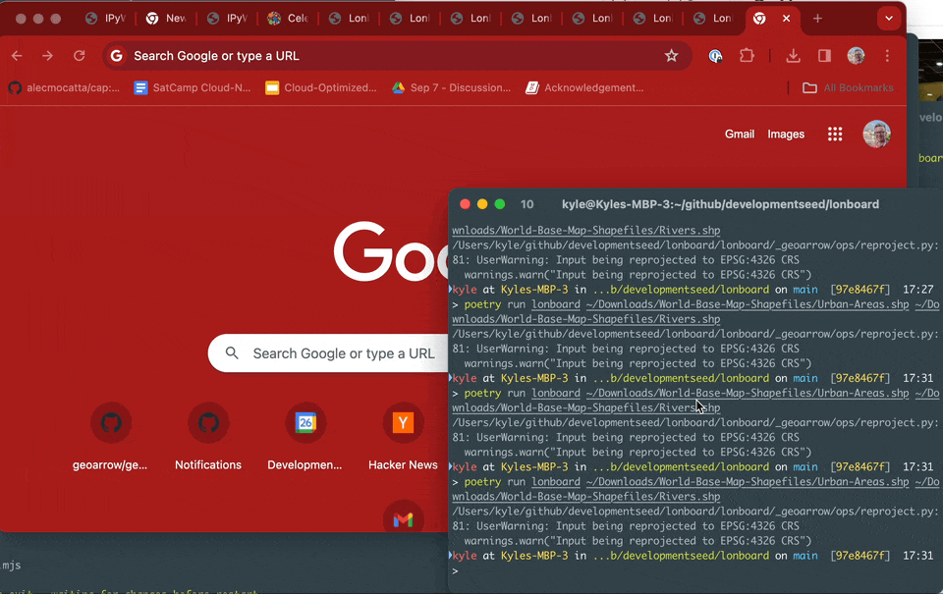
High-level API
CLI Included

Slide 20
Interactive exploration

Slide 21
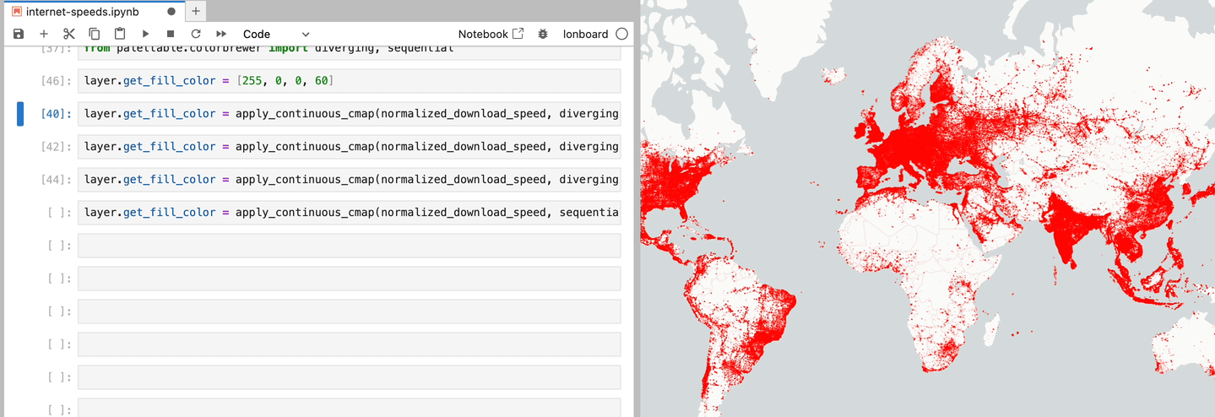
Swap colormaps in a fraction of a second

Slide 22
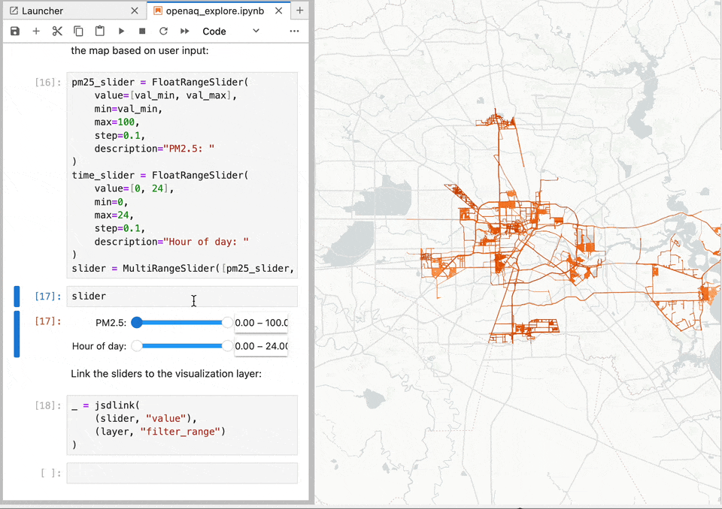
GPU Data Filtering

Slide 23
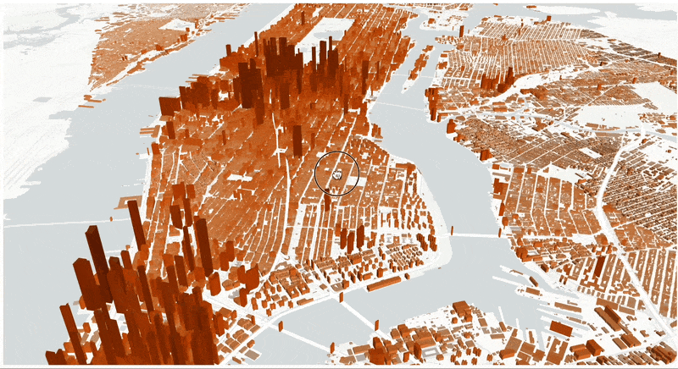
Buildings data

Slide 24
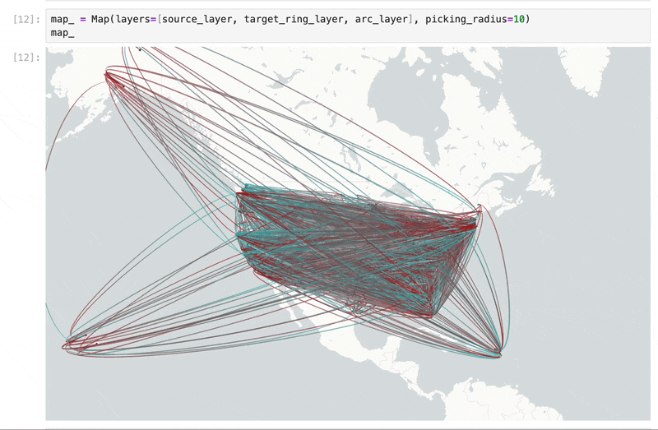
County-to-County Migration

Slide 25
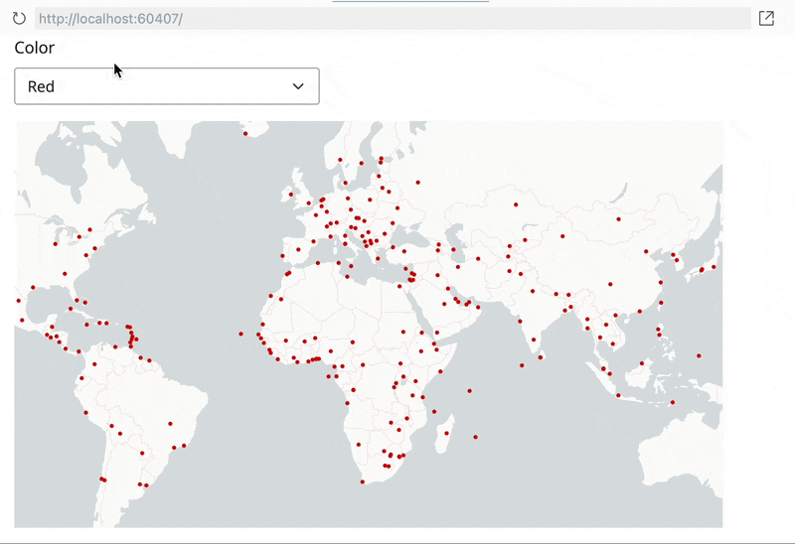
Dashboard integration
e.g. Shiny, Panel

Slide 26

What’s in a name?
A "deck" is the part of a skateboard you ride on. What's a fast, geospatial skateboard?
A lonboard.
Credit Kiri Carini & Dall-E & internet skateboarders’ training data

Slide 27
Ecosystem motivations

Slide 28

Enabling faster geospatial data science
Development Seed
Geospatial consulting for climate & international development
Choose partners that are aligned on open-source
I’m lucky to have most of my time free for open-source development to enable faster geospatial data science
Lonboard development partially funded by NASA contract & OpenAQ
Notes:
Take a step back

Slide 29
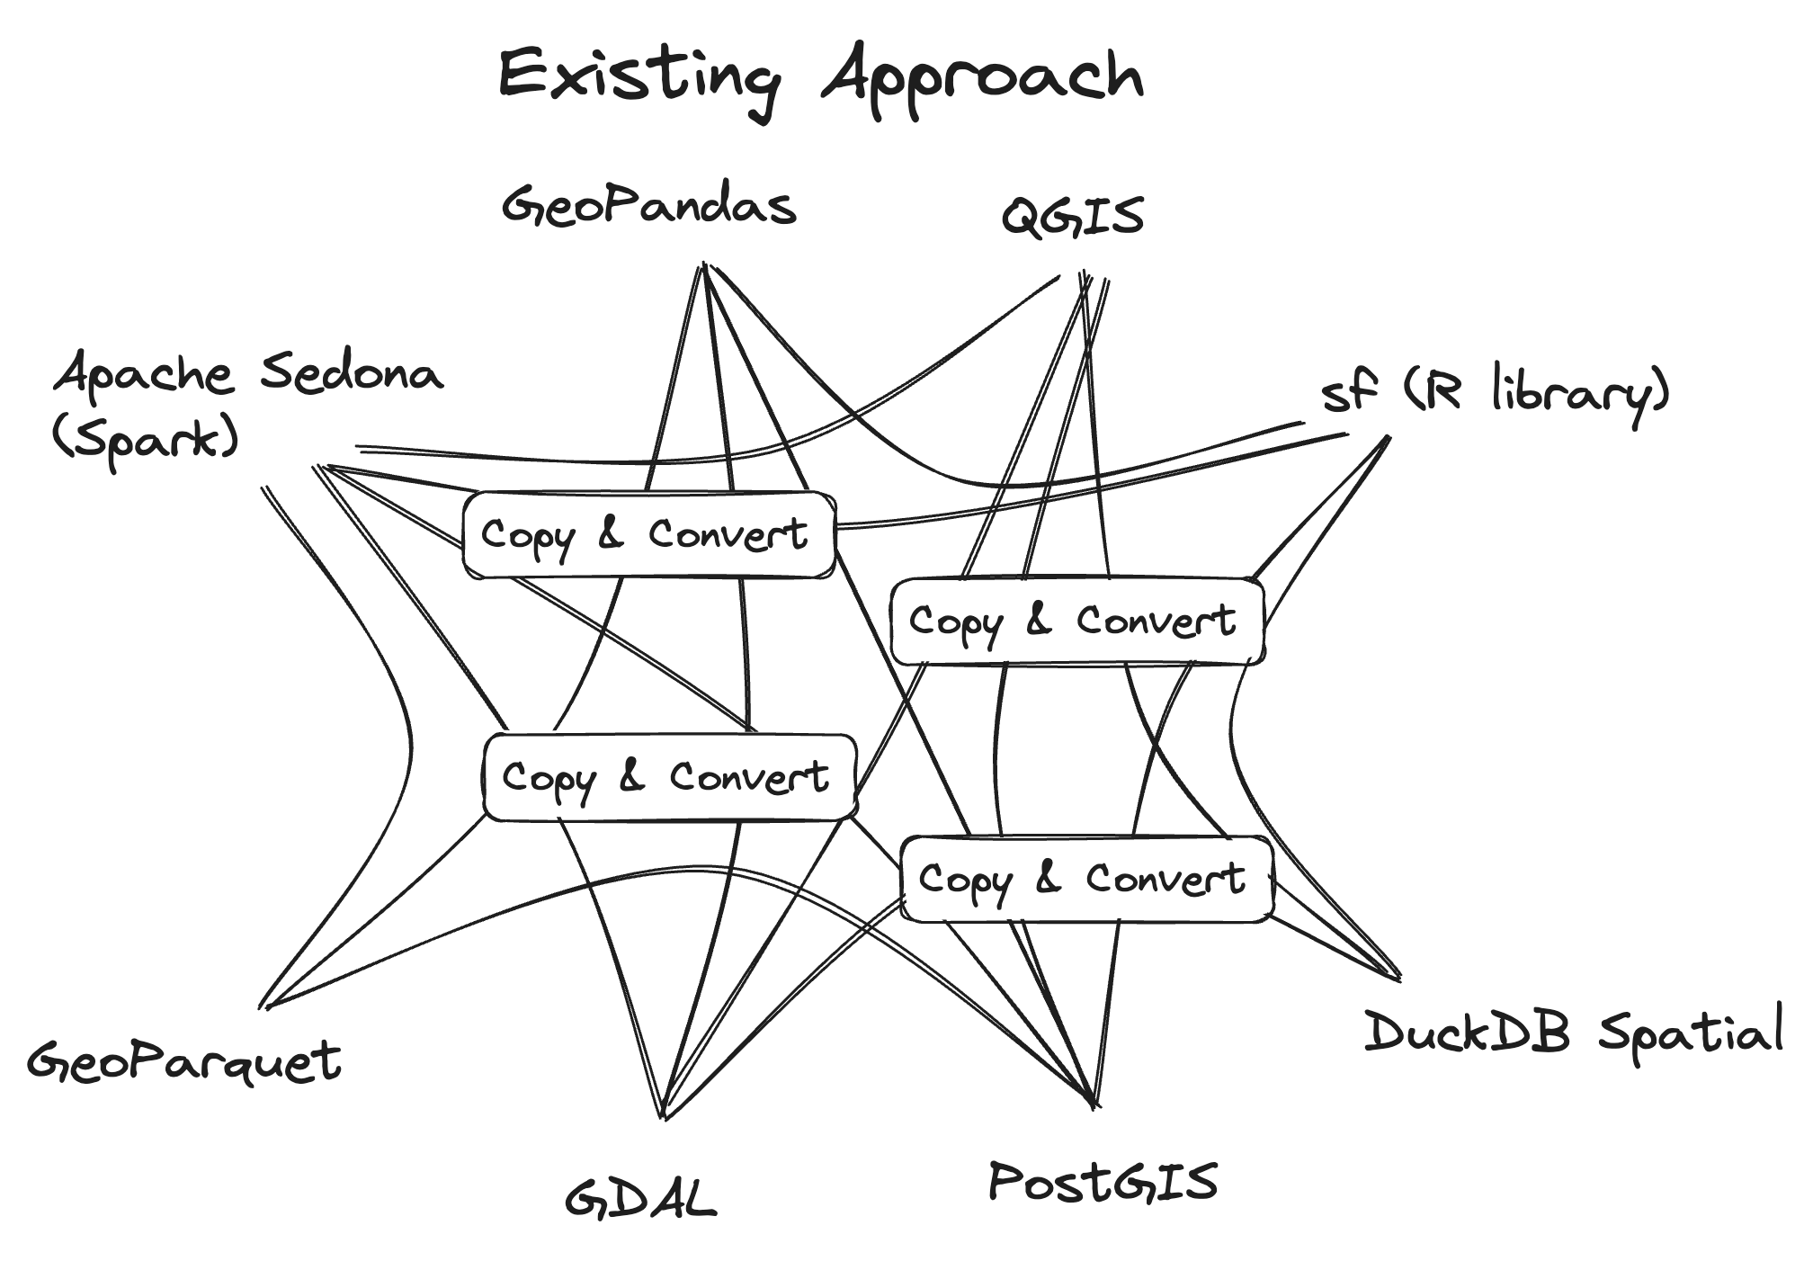
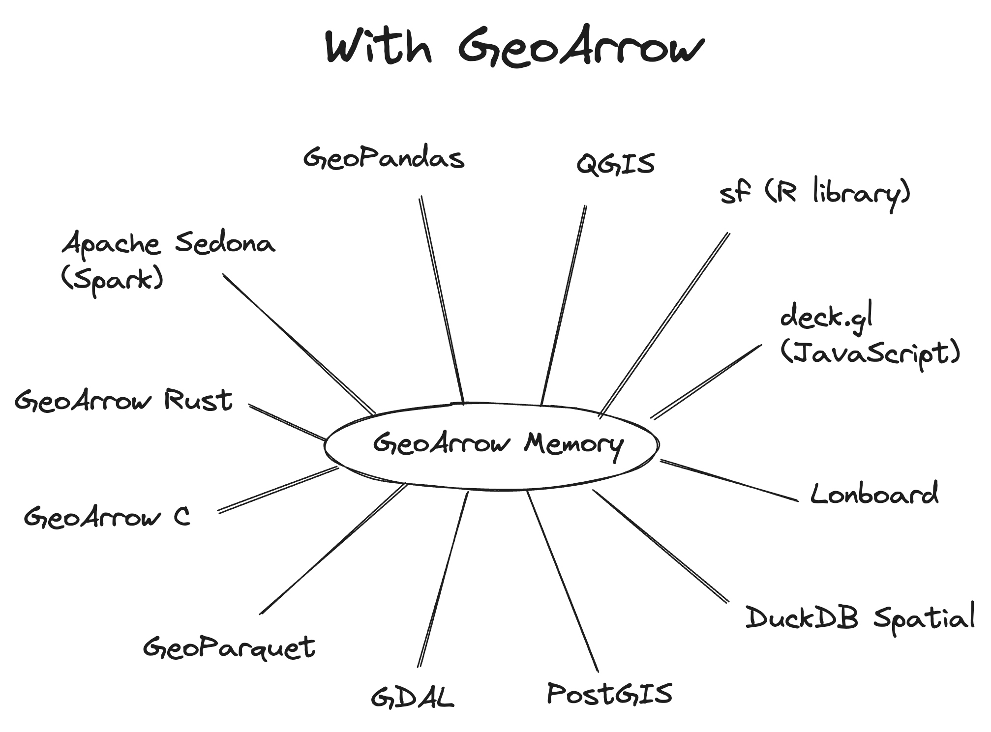
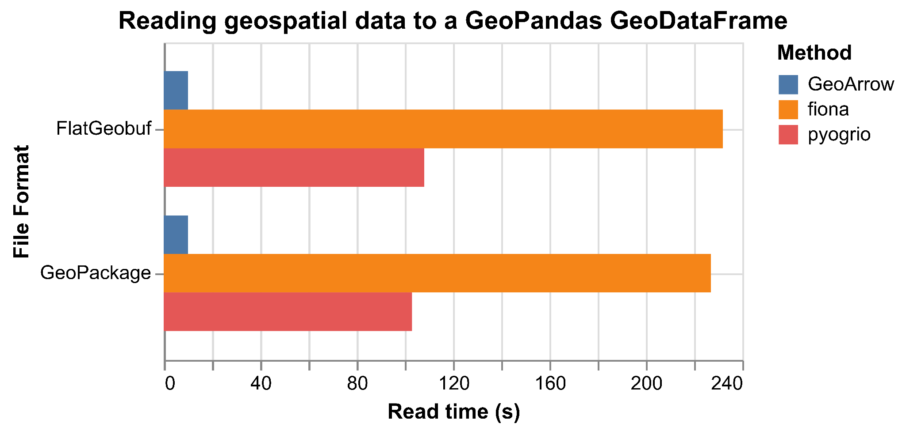
Enabling zero-copy data sharing for geospatial
GeoArrow
Problem: Expensive to copy & convert geospatial tabular data between libraries and languages
Binary data protocol for geospatial tabular data.
Language-independent, zero-copy data sharing

Slide 30
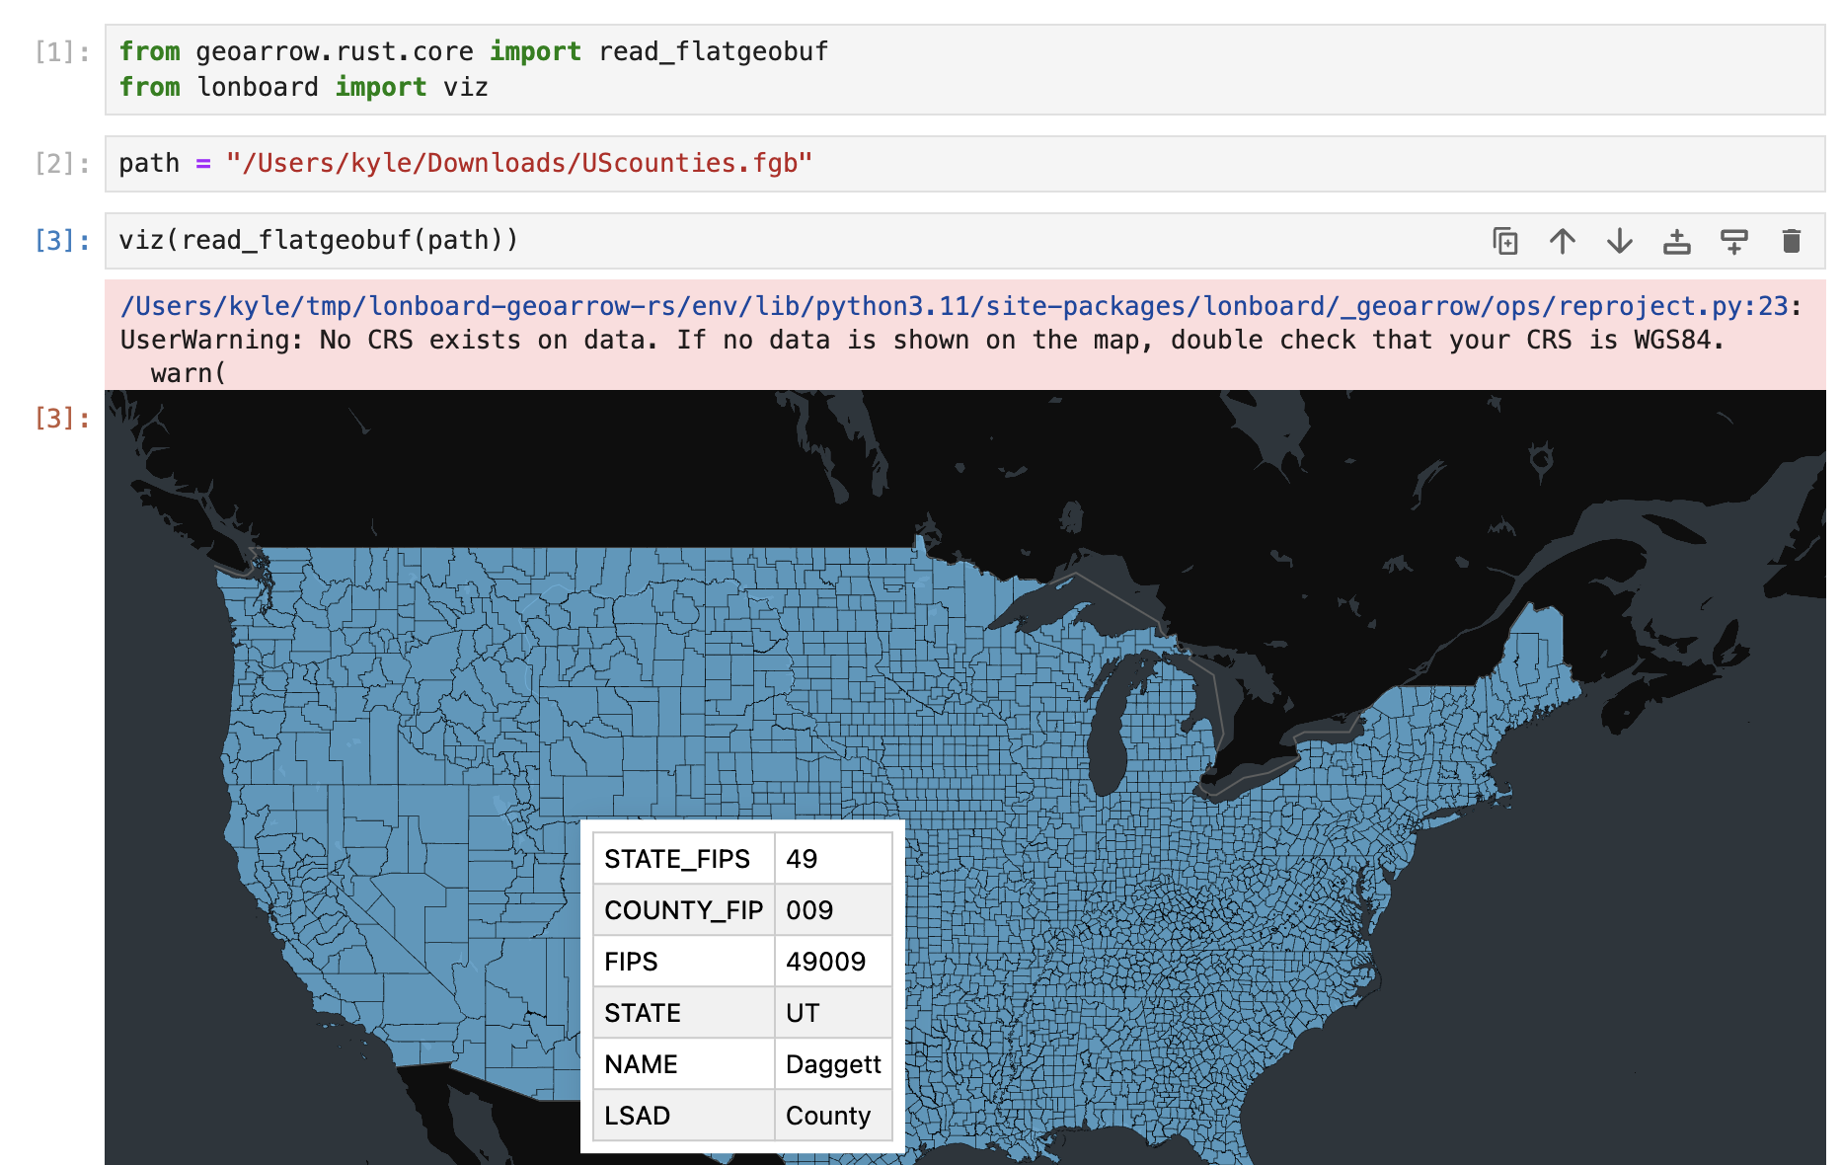
GeoArrow as the lingua franca of geospatial data
My GeoArrow goals
Make GeoArrow the lingua franca of fast geospatial data
GeoArrow should not be a serialization format to parse from, it should be the output
Build ecosystem; Lonboard success attracts users
Fully GeoArrow under the hood ( from_geopandas just converts input to GeoArrow)
Ecosystem effects: zero-cost integration with other Arrow libraries
Care about exact GeoArrow memory layout to allow zero-copy (deck.gl binary features not sufficient for me)
Compute on GeoArrow memory (GeoPandas alternative)
Focusing on Python (large user base), JS (visualization, browser accessibility), Rust (enabler).
Notes:
Take a step back

Slide 31
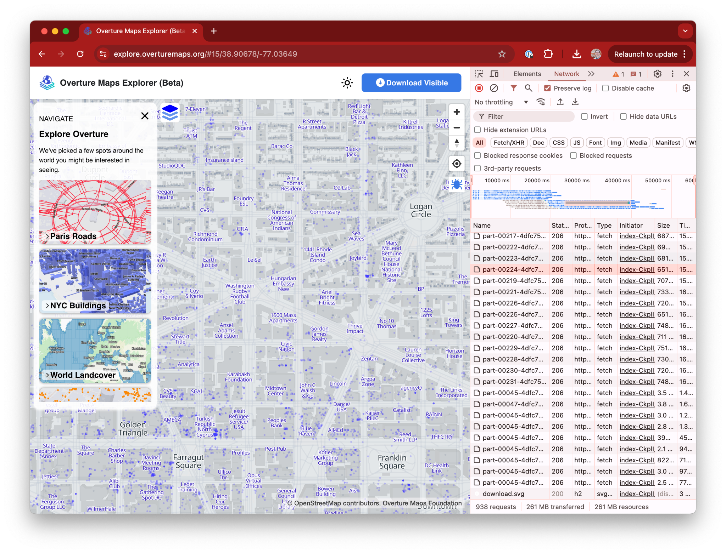
GeoParquet in WebAssembly
Rust-based JavaScript library to read GeoParquet into GeoArrow
<10s to fetch 2100 rows of this bounding box directly from S3 from 2.4 billion row Overture Maps buildings dataset*
*Excluding metadata load (faster metadata load on next website publish)
Emphasis on GeoParquet stability/reliability, GeoArrow output & reusing existing Rust code
Small JS wrapper around same code used for Python
WebAssembly Parquet reading in Overture Maps explorer
(deck.gl not used for rendering)

Slide 32
moar webassembly?
[demo]
jupyterlite.ds.io

Slide 33
Implementation
Details

Slide 34
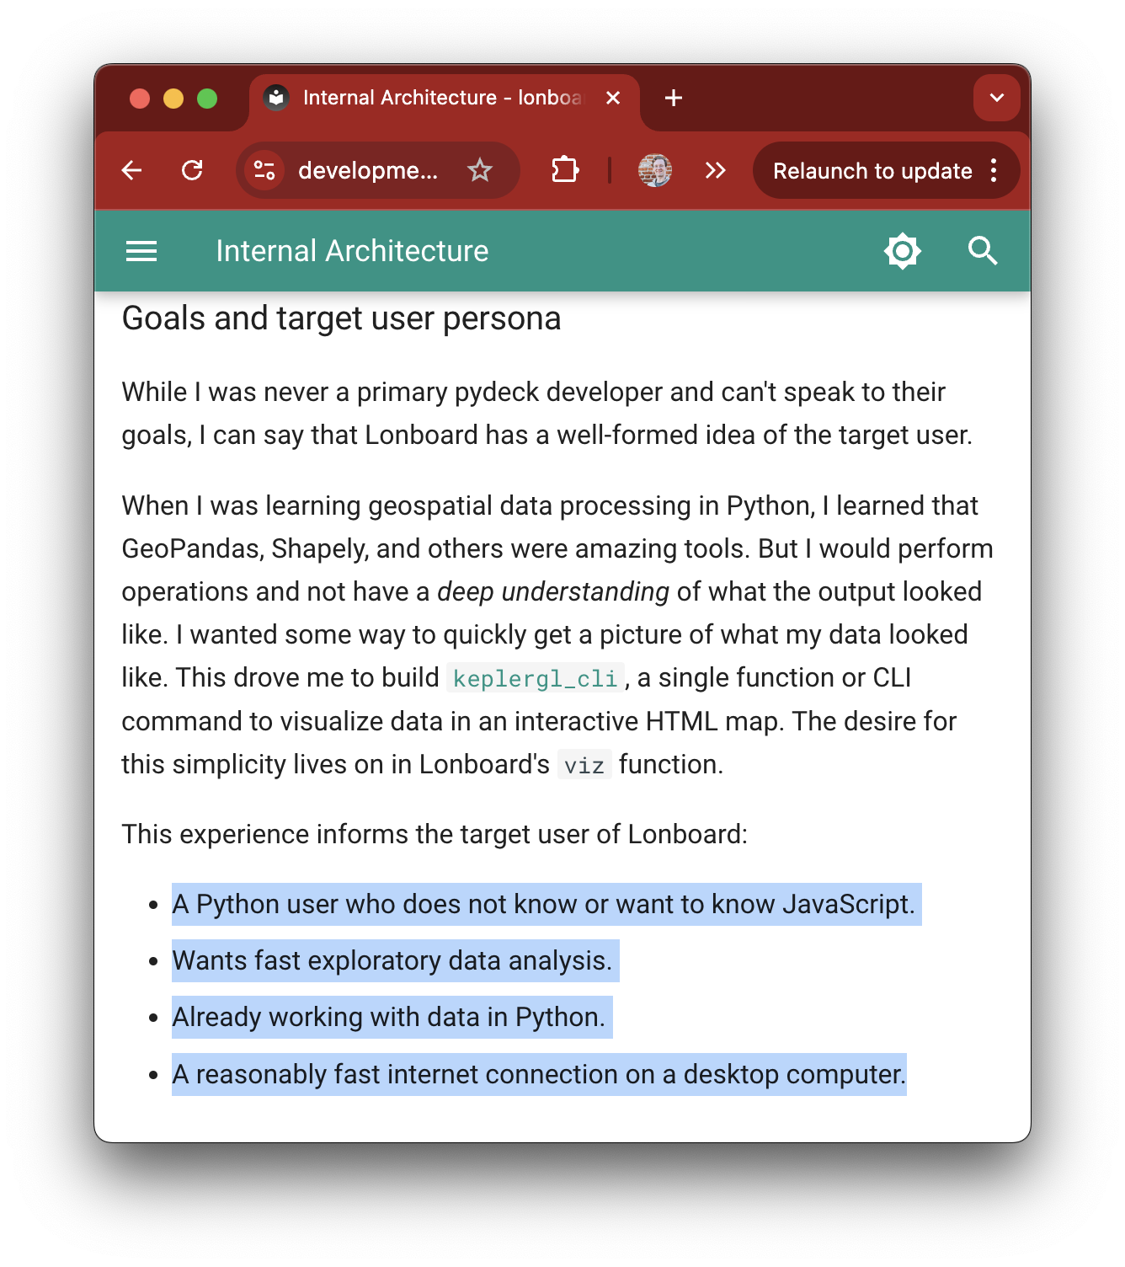
Lonboard Internal Architecture
All data saved as Arrow tables
Data ingest from GeoPandas/DuckDB/Shapely to GeoArrow on the Python side
Serialized to Parquet for transit
Impossible for library to know if the Python env is remote from browser
Parquet-wasm parses data to Arrow
Access data in JS from parquet-wasm
Documentation page online
Notes:
Needed to find meaningful project
Been working with Parquet files
Possible to write this all in JS, but would be a massive time/engineering investment

Slide 35
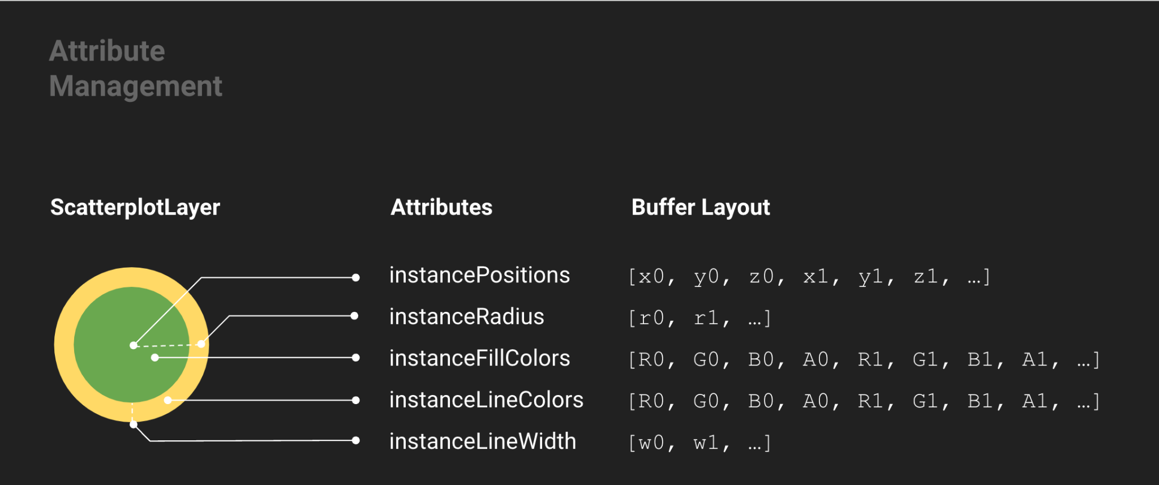
Styling
Full attribute pre-processing
E.g. colors are provided as a numpy array, that array is serialized to Parquet, and passed as a binary attribute to deck.gl
No function serialization, no "@@=properties.valuePerSqm"
Downside:
No support for tiled data (from external sources), because JS would have to apply styling
deck.gl Technical Deep Dive (Xiaoji)
Notes:
Needed to find meaningful project
Been working with Parquet files
Possible to write this all in JS, but would be a massive time/engineering investment

Slide 36
@geoarrow/deck.gl-layers
Primitive GeoArrow arrays:
Point, LineString, Polygon, MultiPoint, MultiLineString, MultiPolygon
Renders Multi-geometries as single geometries
“Explode” table attributes as needed
E.g. color provided as one color per geometry, we need one color per vertex
Manages row index lookup for picking
Notes:
Needed to find meaningful project
Been working with Parquet files
Possible to write this all in JS, but would be a massive time/engineering investment

Slide 37
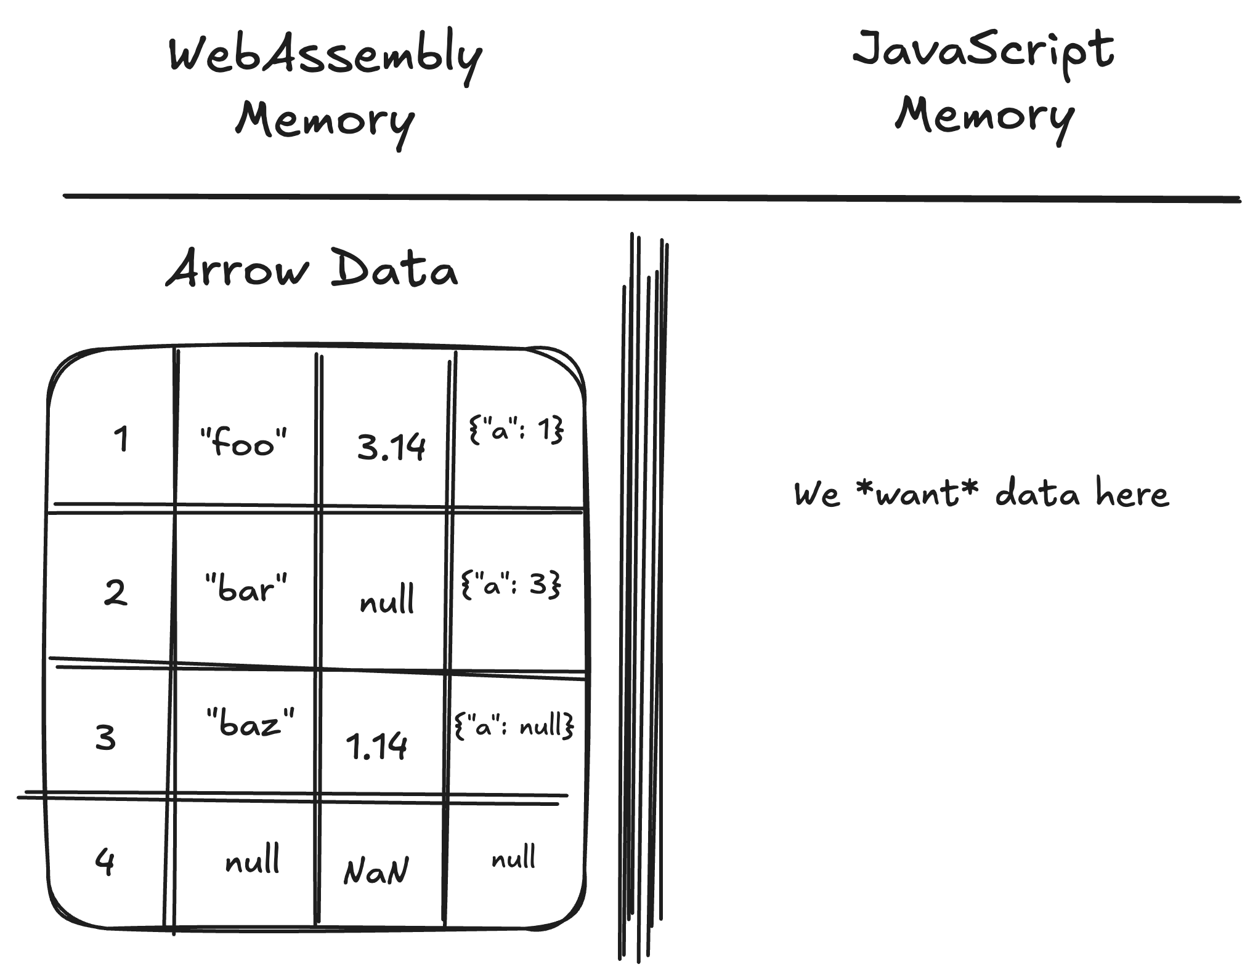
WASM Data Boundary
We’ve parsed Parquet to Arrow in WASM…
But we really want this data in JavaScript
Notes:
Needed to find meaningful project
Been working with Parquet files
Possible to write this all in JS, but would be a massive time/engineering investment

Slide 38
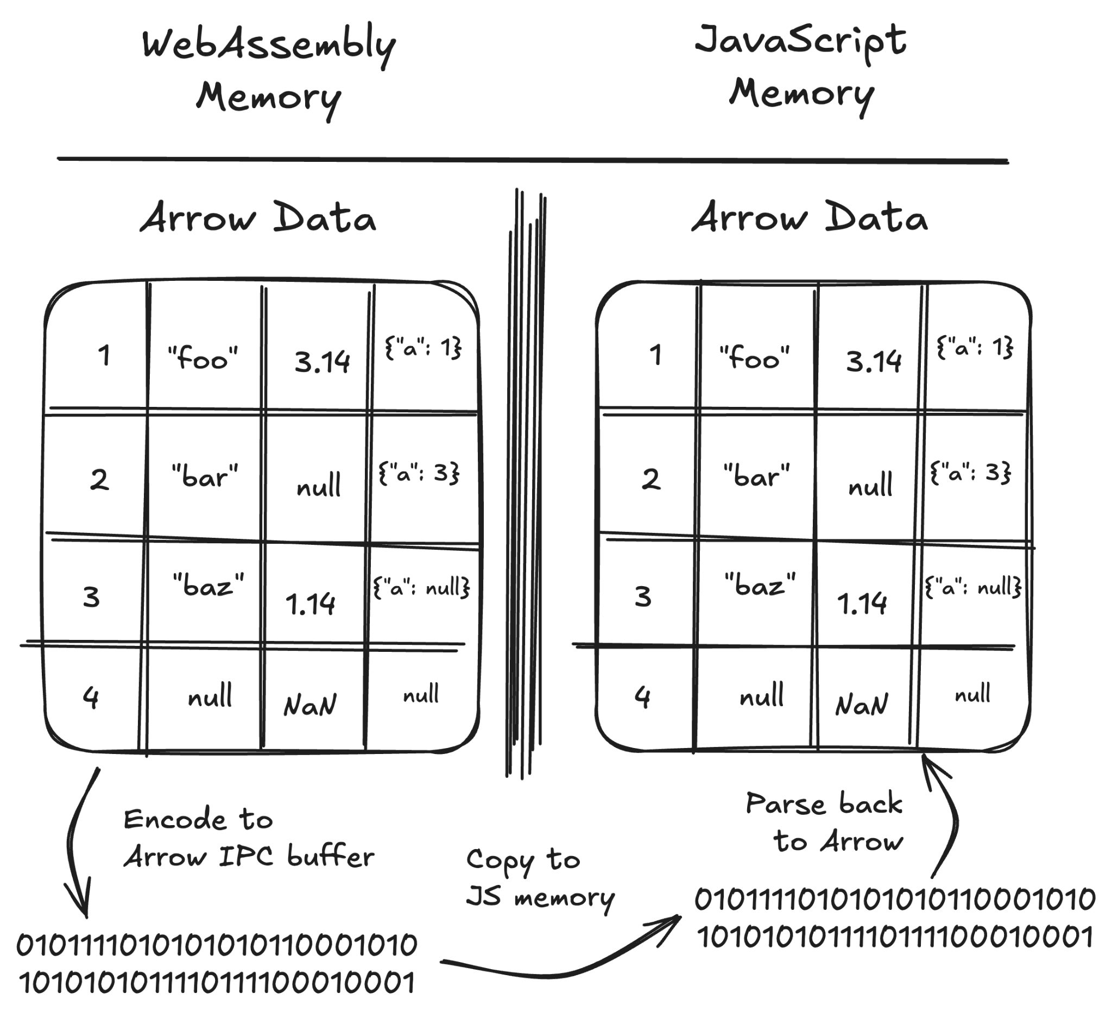
Arrow IPC option
Serialized buffer
Default option:
Serialize to Arrow IPC
Parse back with Arrow JS
We just parsed to Arrow… now we have to encode it to get it out of WASM??
Two full memory copies
(No copy needed from Arrow IPC on the JS side)
Notes:
Easy but has overhead

Slide 39
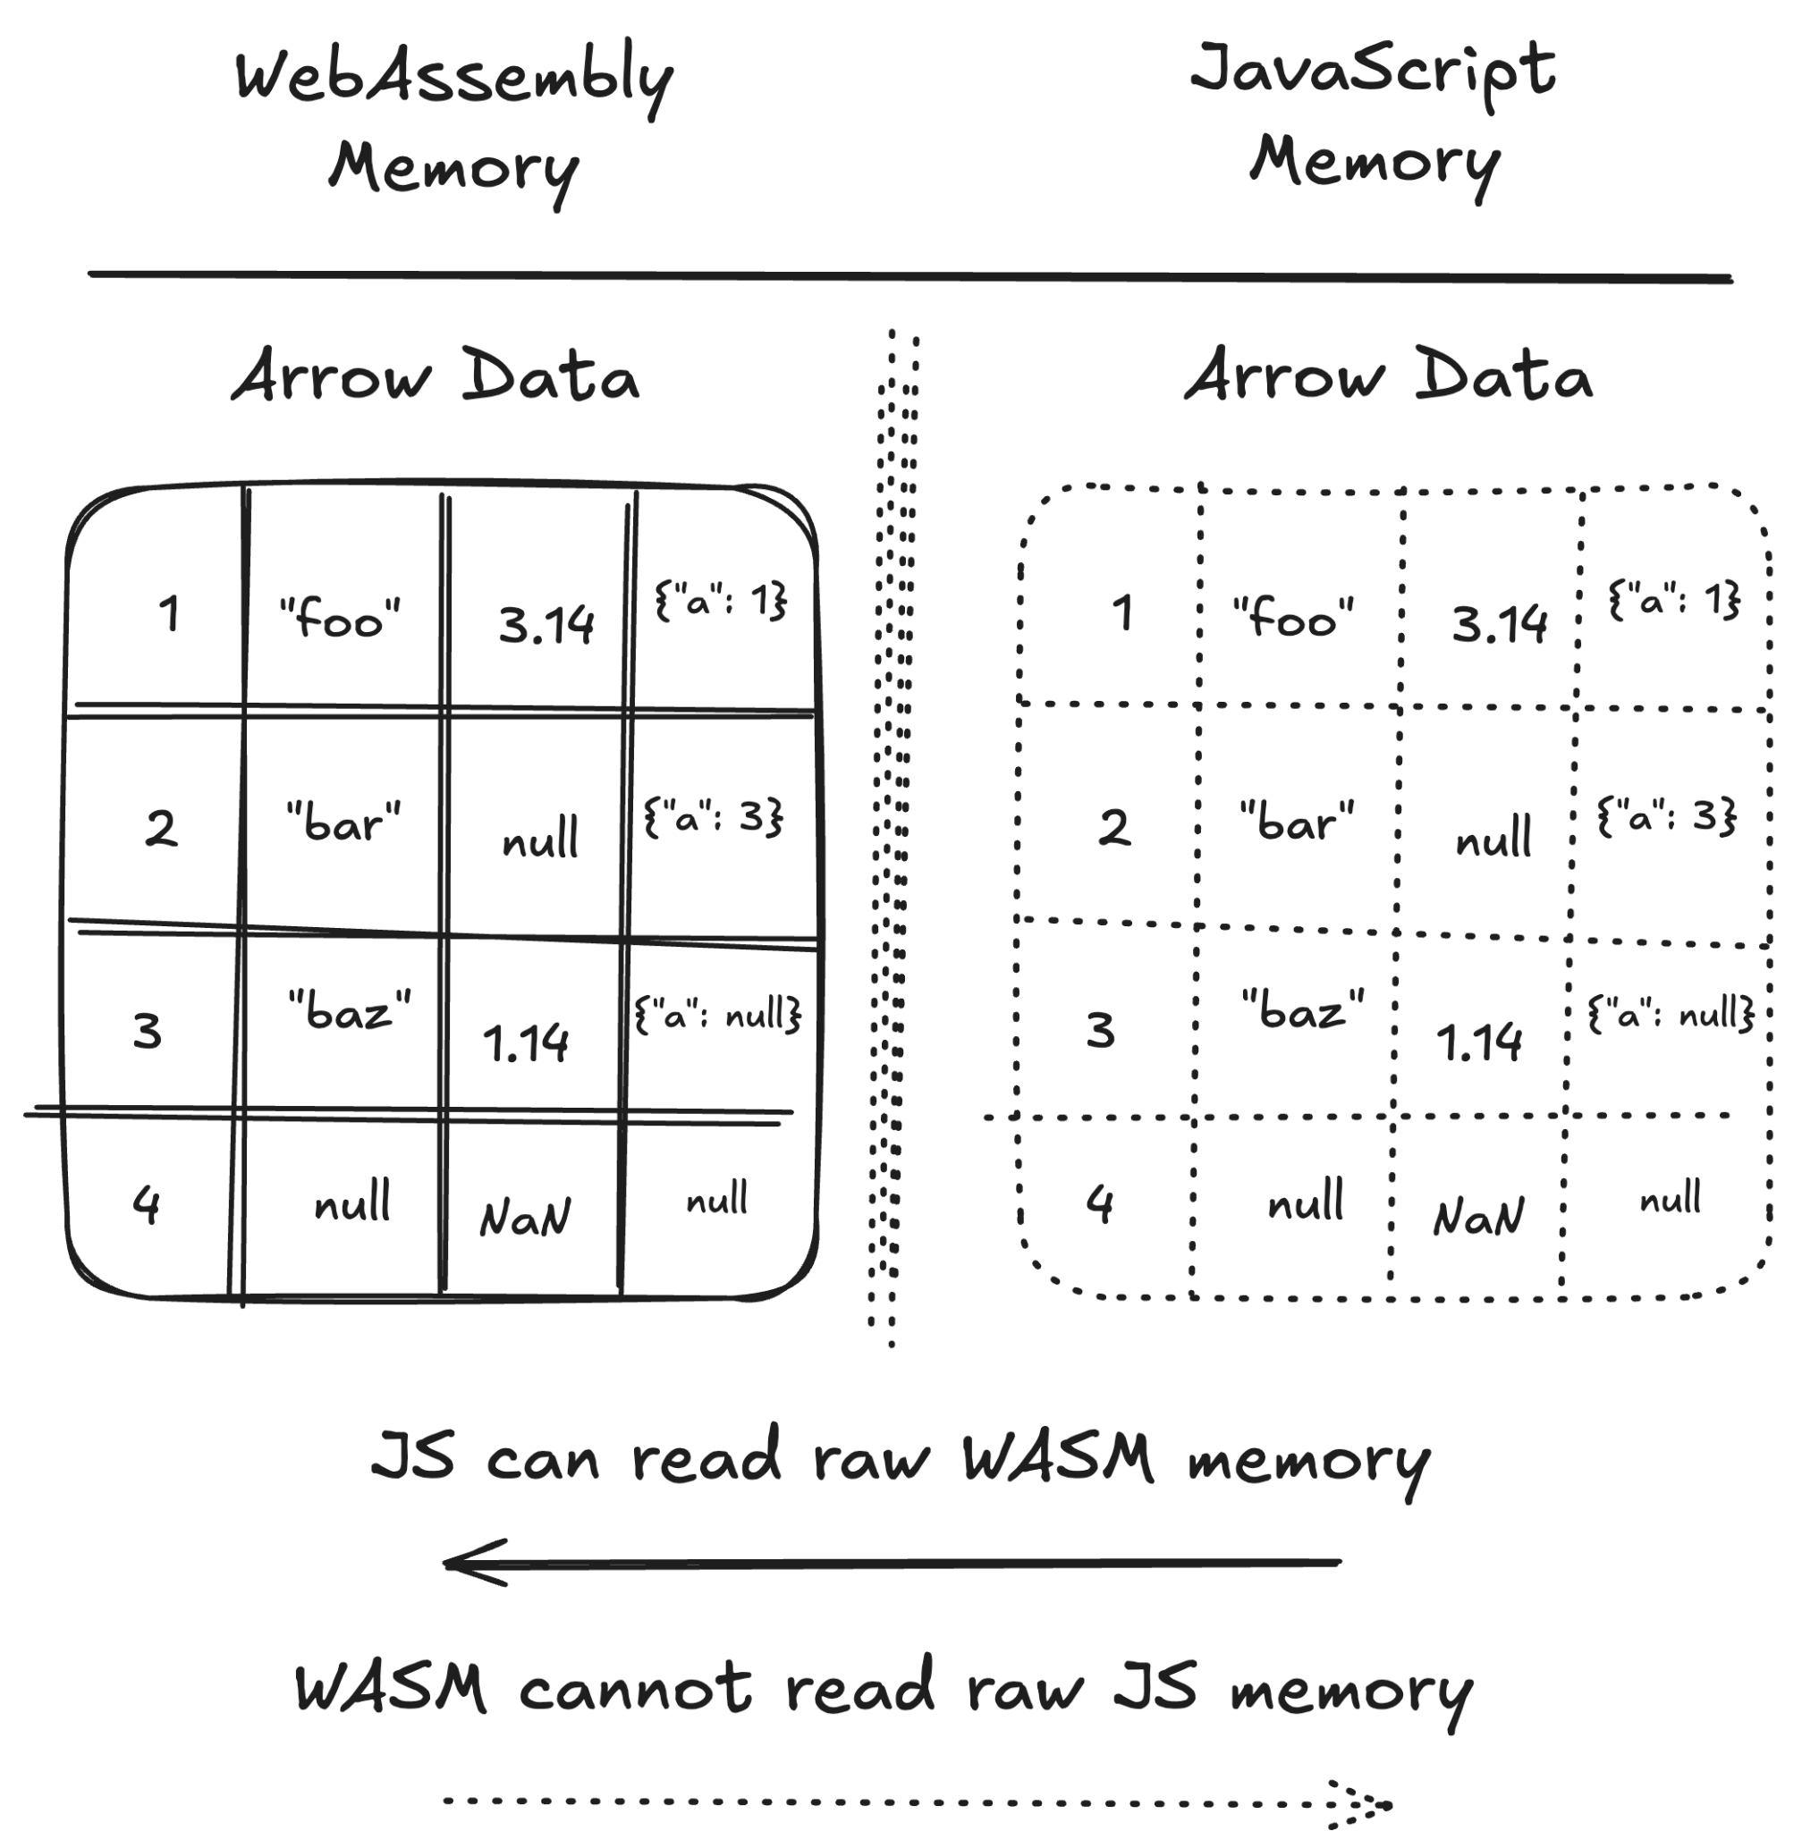
Avoiding extra data copies
Direct views?
Arrow is language-independent
Arrow JS and whatever Arrow implementation is used in Wasm (Rust, C++, etc) all have the same underlying representation
Can we avoid copies?
Notes:
A slightly porous boundary

Slide 40
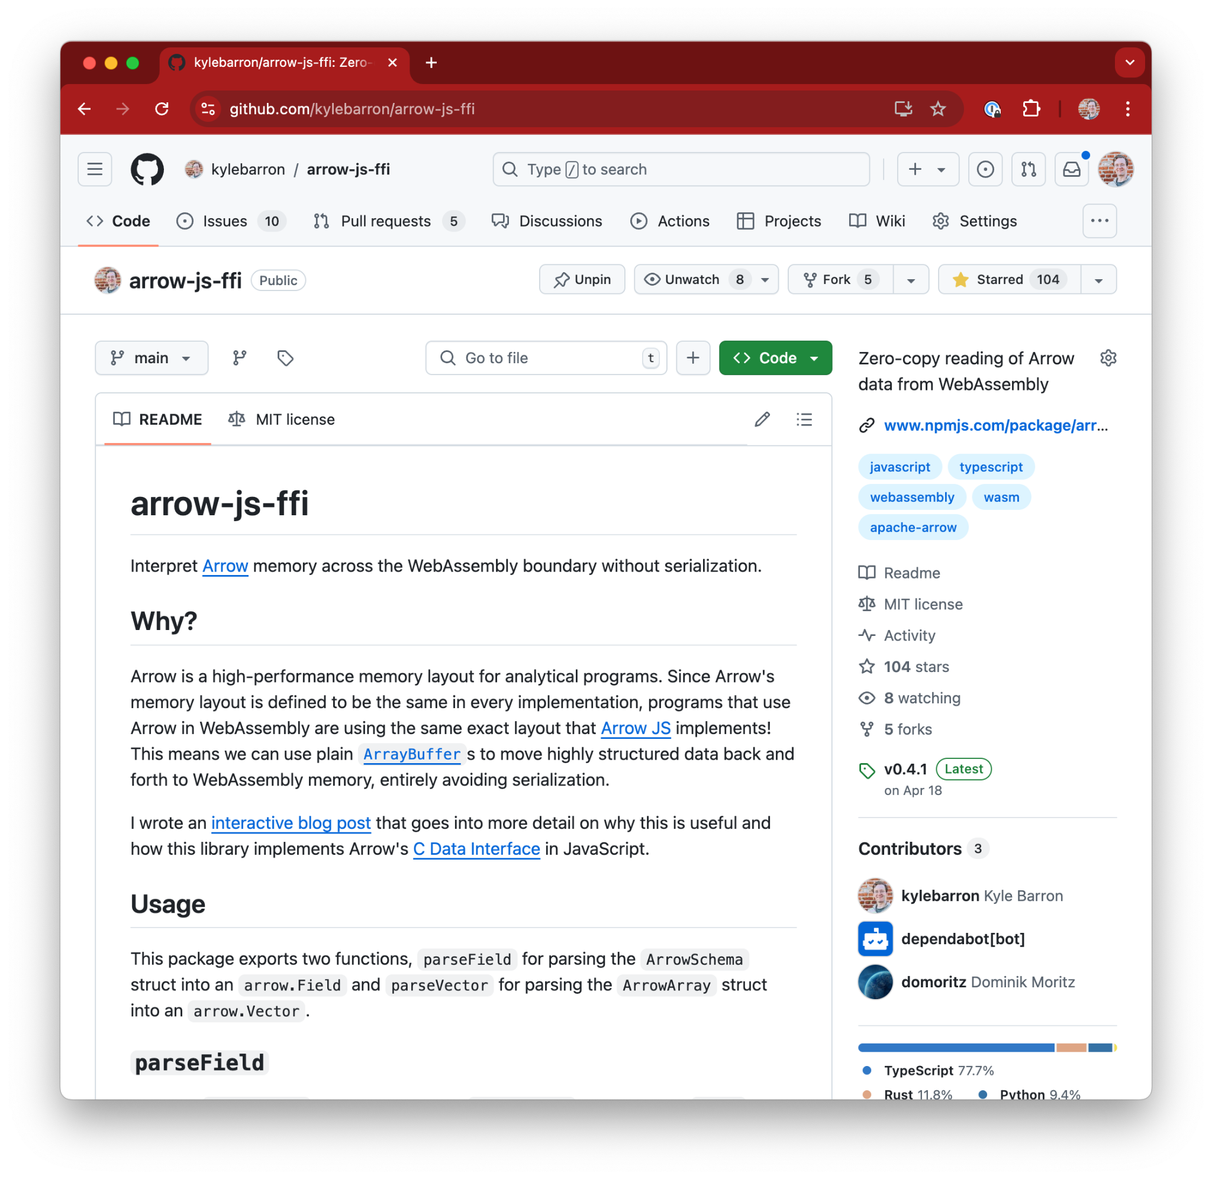
arrow-js-ffi
View or copy Arrow data directly from Wasm
Not generally too much overhead for most use cases, but for pyodide is important for lowering memory pressure (both serialization on the Python side and deserialization on the JS side)
Hoping to enable by default in next Lonboard release
Zero-copy from WebAssembly only possible because I’m using Arrow exactly
Notes:
Needed to find meaningful project
Been working with Parquet files
Possible to write this all in JS, but would be a massive time/engineering investment

Slide 41
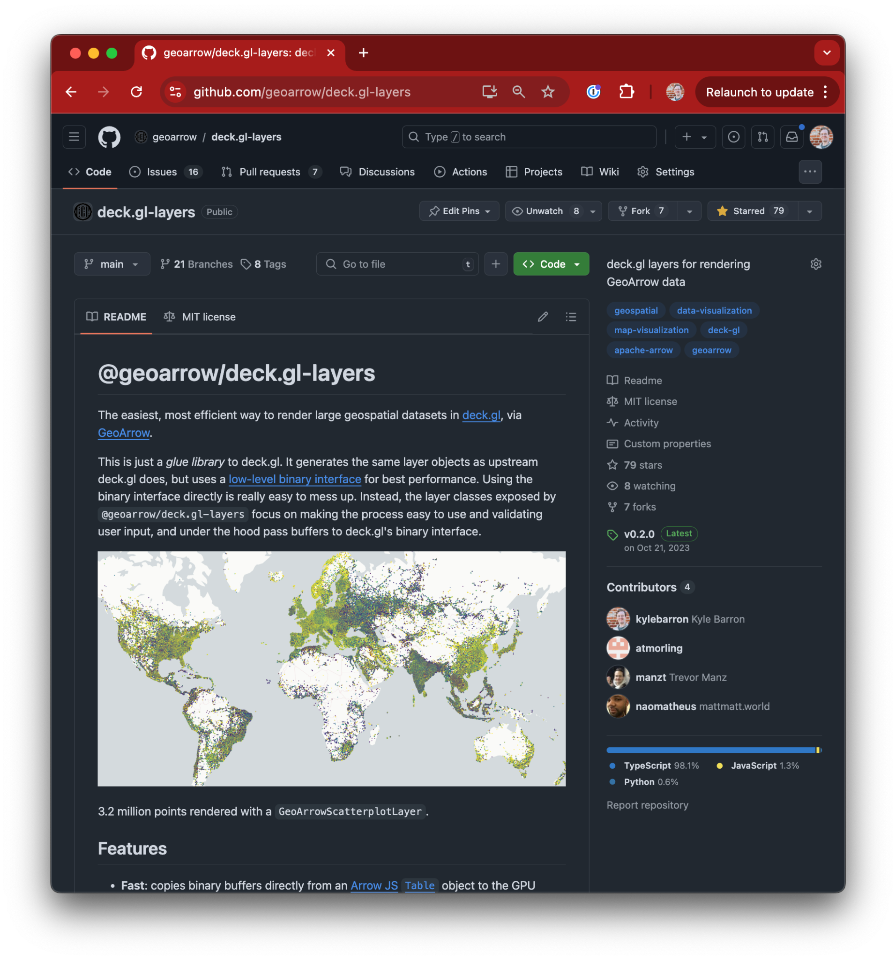
@geoarrow/deck.gl-layers
Wrapper library to handle GeoArrow input
Passes Arrow buffers as binary attributes
No copies or modifications to input data
Runs earcut on worker thread
No custom layer implementations
Relatively stable and I haven’t worked on it lately
Refactor to take RecordBatch input instead of Table: Reliably render one deck.gl layer sublayer
Also forked into deck.gl-community repo
(Most recent Lonboard work on the Python side)
Notes:
Needed to find meaningful project
Been working with Parquet files
Possible to write this all in JS, but would be a massive time/engineering investment

Slide 42
Future Work

Slide 43
New Lonboard release
deck.gl v9, deck.gl controls
Lonboard in pyodide in WebAssembly (wrote Rust port of pyarrow to enable smaller Python Arrow environments)
removed pyarrow, pandas, geopandas, shapely, matplotlib, palettable as required dependencies
Categorical data filtering
Bounding box data selection. Bbox drawing works, but haven’t implemented picking (need to match deck.gl layer ids to Python layer instances)

Slide 44
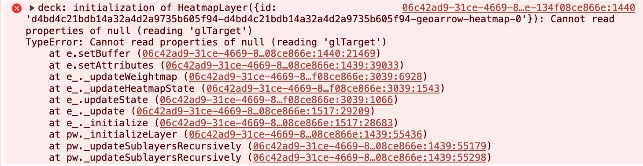
Re-enable HeatmapLayer
Our use of HeatmapLayer broke in deck.gl v9 upgrade
Haven’t had time to create minimal reproducible example yet

Slide 45
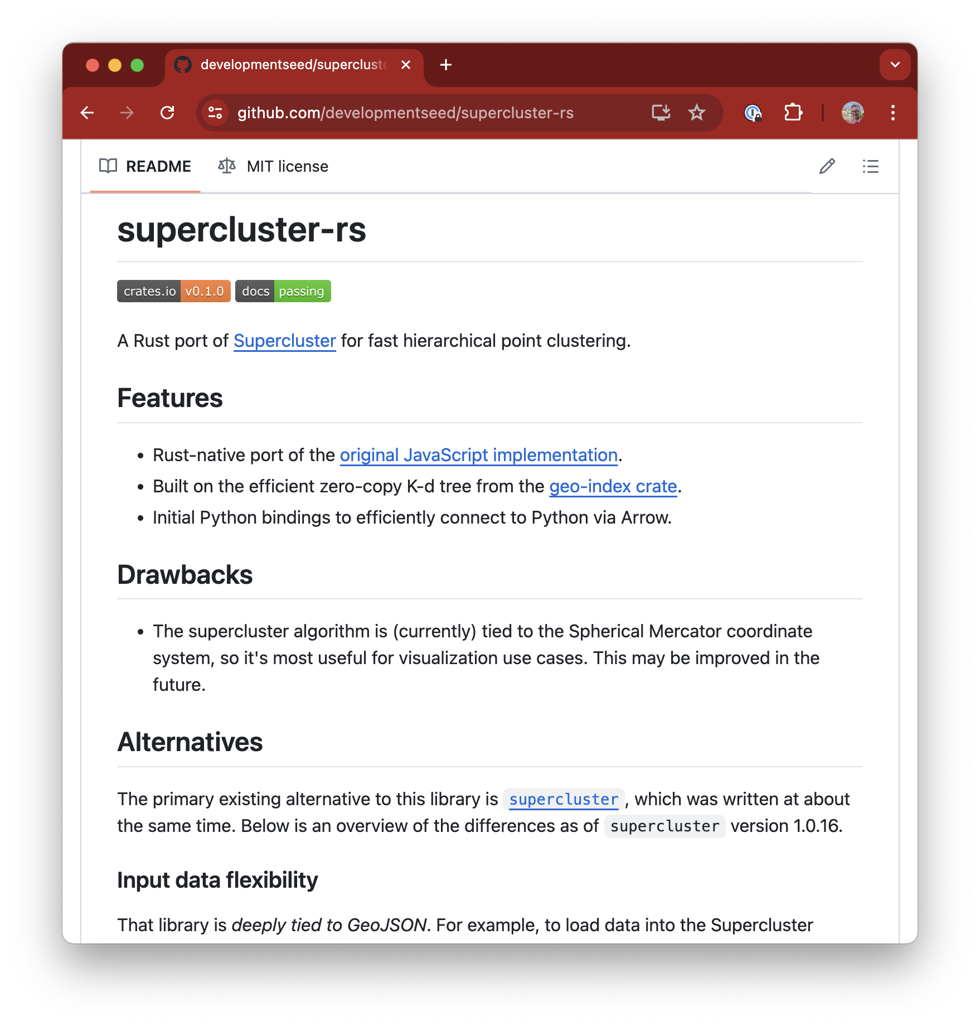

Scalable rendering
Today all user input is sent to browser
In the future:
Smarter relationship between Python and JavaScript
Efficient spatial indexes in Rust/Python
Transfer small portions of input, depending on map’s view

Slide 46
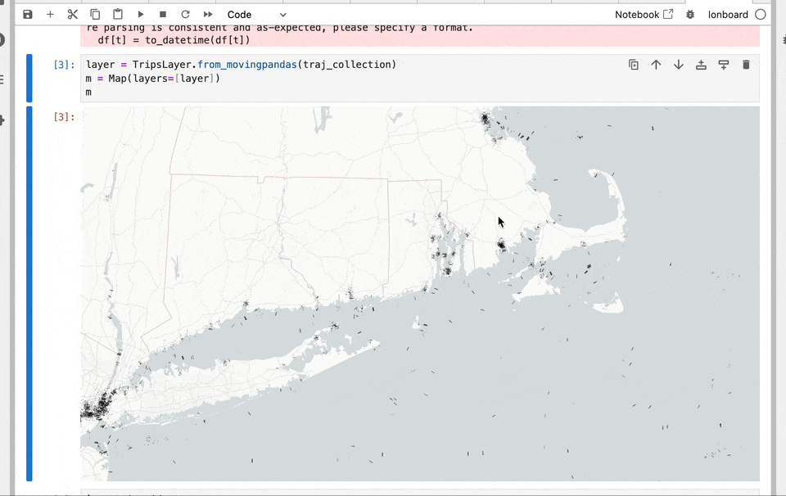
ds.io/lonboard
TripsLayer

Slide 47
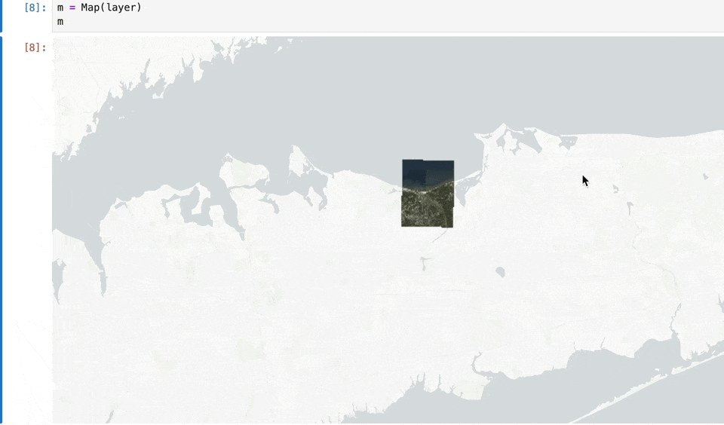
Raster data rendering
We support PNG tile servers today
Future: automatic integration with Python rasterio objects
Potential threading/async issues on the Python side

Slide 48
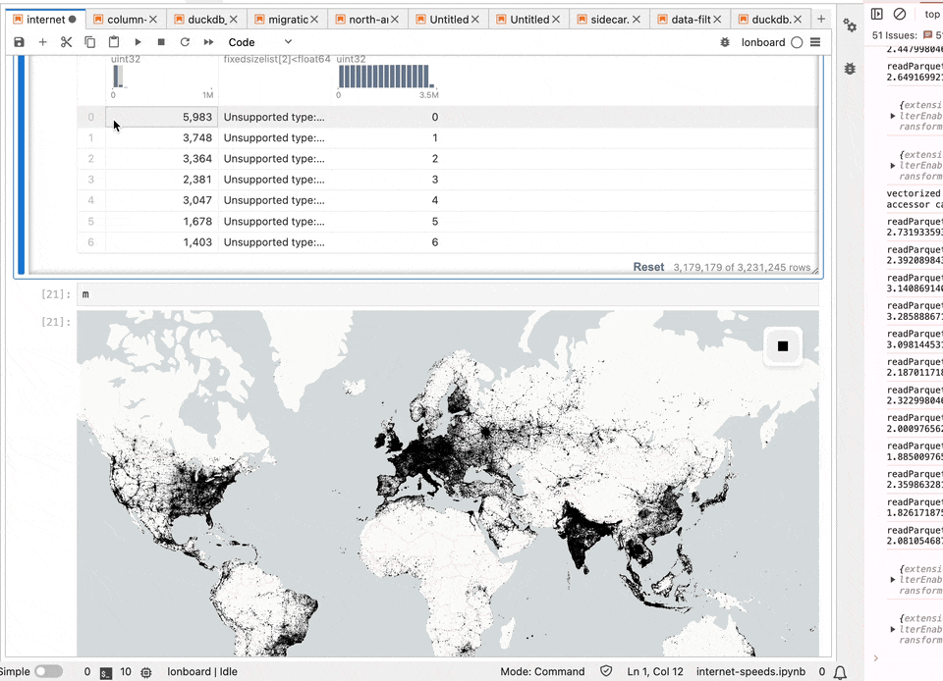
Data cross filtering
Integrated cross filtering with quak, a tabular data viewer/profiler on top of DuckDB
Construct an Arrow bit mask for whether each row should be rendered, pass that to deck.gl’s categorical data filter

Slide 49
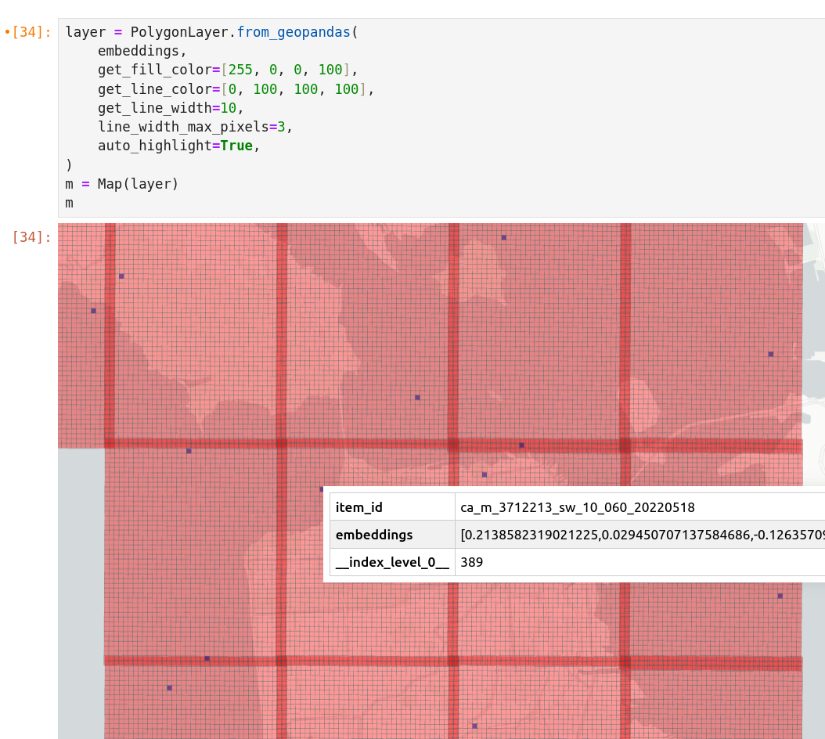
deck.gl-geoarrow updates
Separated coordinates (XXXX, YYYY)
For now, copy to interleaved buffer
Mixed & GeometryCollectionArray support
Equivalent to GeoJSONLayer (figures out which underlying layers to render)
GeometryCollection Support
Bug with autoHighlight with multi polygons
Allow passing in “nested” accessors
E.g. one color per vertex, not per geometry
TripsLayer: color based on current speed
Arrow list nesting needs to match geometry nesting
Bug in autoHighlight: when hovering on one Polygon, many other polygons are highlighted.

Slide 50
More GeoArrow in JavaScript
Python focus so far to simplify data pipeline.
Lonboard controls data producer and consumer
In JS: Make it easier to load formats as GeoArrow
FlatGeobuf, GeoParquet, GeoJSON, WKB, WKT Shapefile (soon)
Again, I personally, am focused on exact Arrow memory layout
I personally am focused on WebAssembly to leverage the same underlying Rust code for Python and JS
Notes:
Needed to find meaningful project
Been working with Parquet files
Possible to write this all in JS, but would be a massive time/engineering investment

Slide 51
Zero-copy rendering from Pyodide
(Python in WebAssembly)
Arrow-js-ffi can view Arrow data in WebAssembly from JS without copies
Same principle works with data in
Working early prototype
Instant rendering
Only possible because GeoArrow in Python and @geoarrow/deck.gl-layers use the exact same memory layout
Notes:
Needed to find meaningful project
Been working with Parquet files
Possible to write this all in JS, but would be a massive time/engineering investment

Slide 52
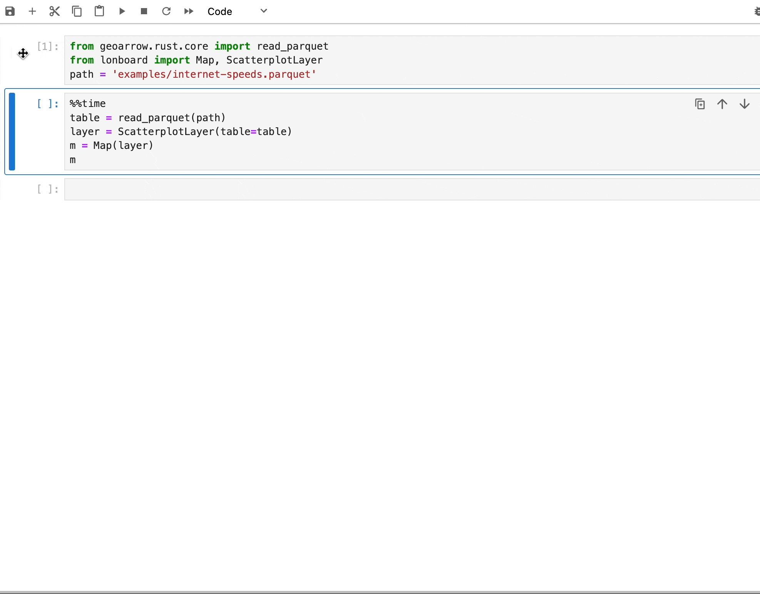
geoarrow-rust <--> Lonboard
1.6s to render 3 million points from disk
Load GeoParquet file from Rust, then pass to Lonboard
Rust -> Python -> pyarrow (C++) without copies

Slide 53

Thank you!
ds.io/blog
ds.io/Lonboard
geoarrow.org
Podcasts:
Mapscaping (GeoParquet)
Matt Forrest (Lonboard & GeoArrow)
Browsertech (JavaScript/WebAssembly)

Slide 54
GeoParquet
Efficient file format for geospatial vector data

Slide 55
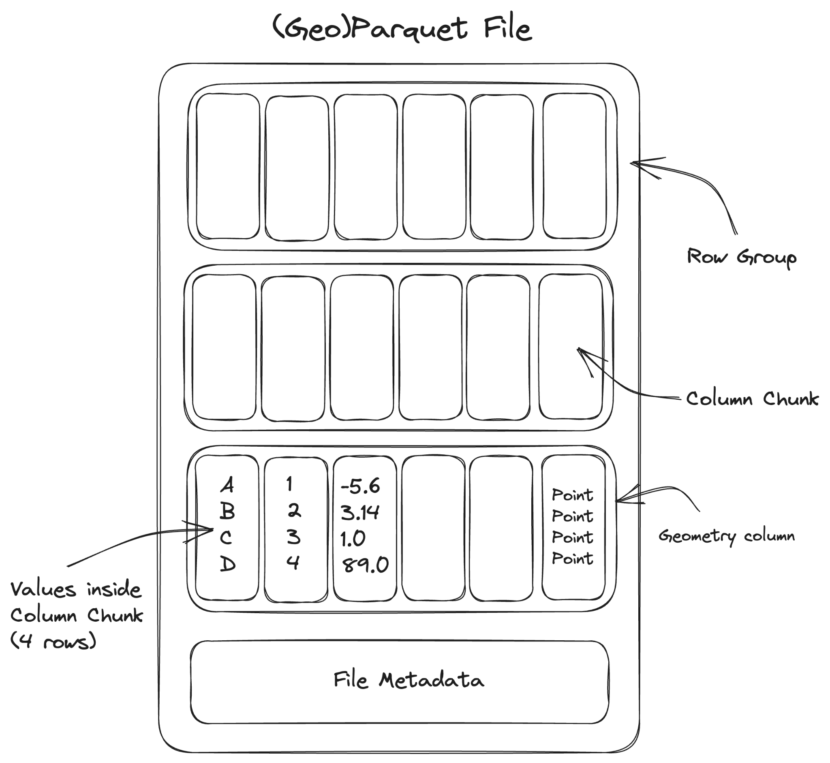
De-facto columnar file format for tabular data
Apache Parquet
Chunked, columnar data format
Extensive type system, including nested types
Extremely efficient compression
Implementations in JS (Wasm), Python, C, Java, Rust, etc.
Widely adopted
Snowflake, BigQuery, RedShift, Databricks
Hadoop, Spark, DuckDB
Pandas, Polars, Velox, DataFusion
Originated in 2013 with Hadoop

Slide 56
Geospatial support for Parquet
GeoParquet
Extends Parquet for geospatial data
Readable by non-geospatial tools
Cloud-native: read chunks of file efficiently via HTTP range requests
Use the same data files for backend analysis and frontend visualization
Increasing adoption:
GeoPandas, QGIS, Apache Sedona, GDAL
Future work: spatial partitioning
Specification at 1.0.0-rc.1

Slide 57
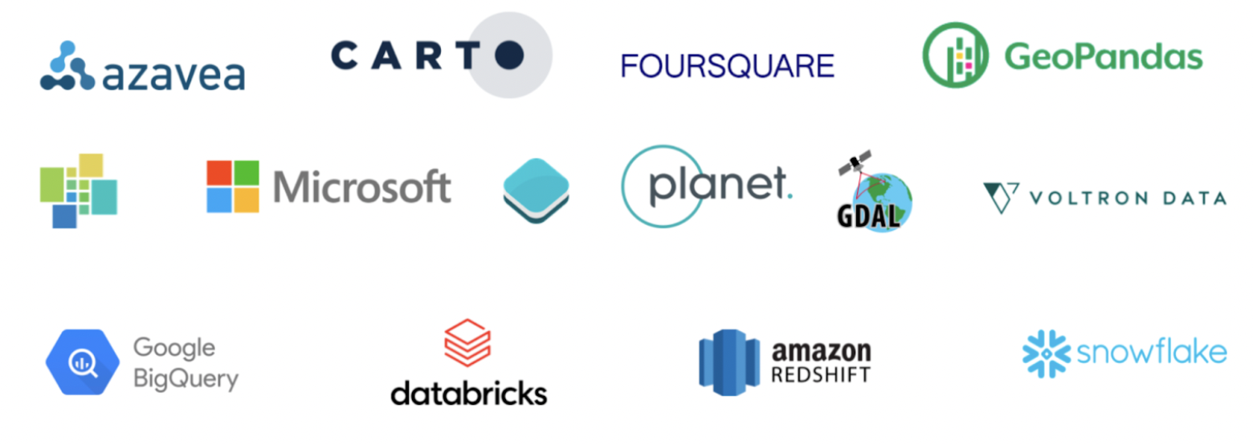
GeoParquet developed by broad community

Slide 58
GeoArrow
Enabling zero-copy data sharing for geospatial

Slide 59
Enabling zero-copy data sharing for scientific Python libraries
Python Buffer Protocol (2006)
Problem: Expensive to copy & convert array data between Python libraries
Solution: Protocol for zero-copy sharing of multi-dimensional array data
Enabled widespread innovation on top of NumPy (v1.0 in 2006)
“This cannot be emphasized enough: it is fundamentally the Buffer Protocol and related NumPy functionality that make Python useful as a scientific computing platform.”
- Jake VanderPlas (An Introduction to the Python Buffer Protocol, 2014)

Slide 60
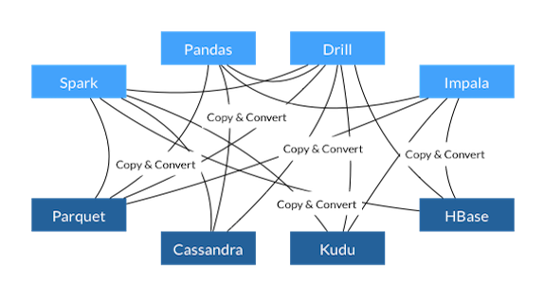
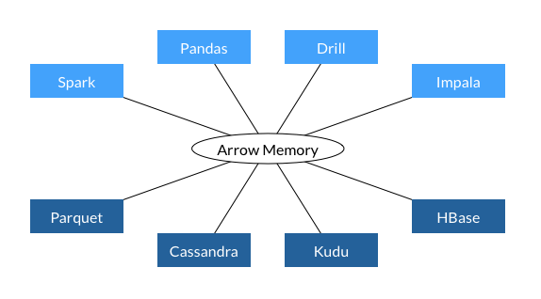
Before Arrow
Enabling zero-copy data sharing for tabular libraries
Apache Arrow (2015)
With Arrow
Problem:
Pandas library for tabular data implemented on top of NumPy
Expensive to copy & convert tabular data between languages
Solution:
Protocol for language-independent zero-copy sharing of columnar tabular data
Extensive type system, including nested types
Become the standard memory format for modern analytical tools:
Pandas, Polars, Velox, DuckDB, DataFusion, R, cuDF
Loading a Parquet file gives you Arrow memory
Notes:
Motivating the talk in the reverse direction
DuckDB can operate on Python Arrow tables without copy

Slide 61
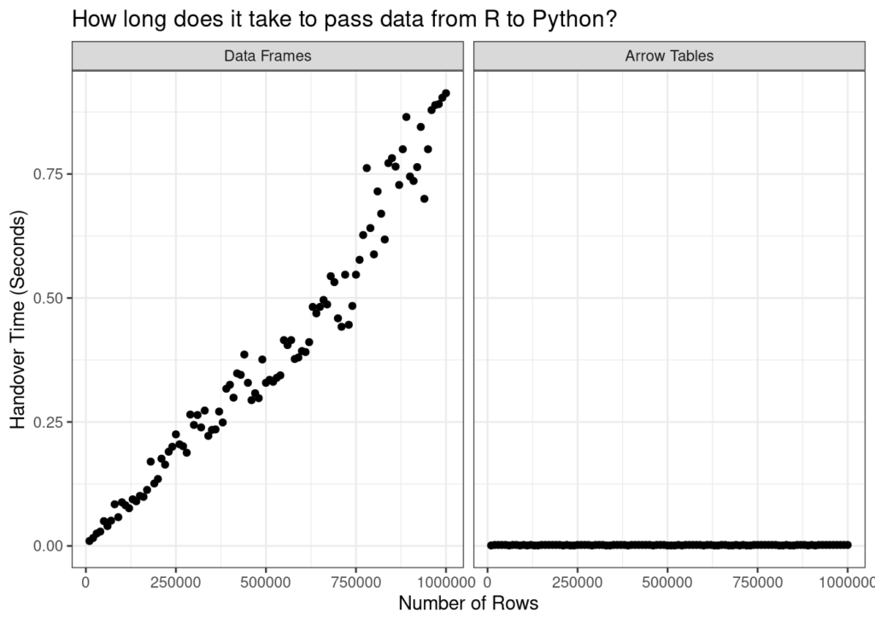
Enabling zero-copy data sharing for tabular libraries
Apache Arrow (2016)
Data movement is always O(1)
Danielle Navarro (Passing Arrow data between R and Python with reticulate)
Notes:
Motivating the talk in the reverse direction
DuckDB can operate on Python Arrow tables without copy

Slide 62
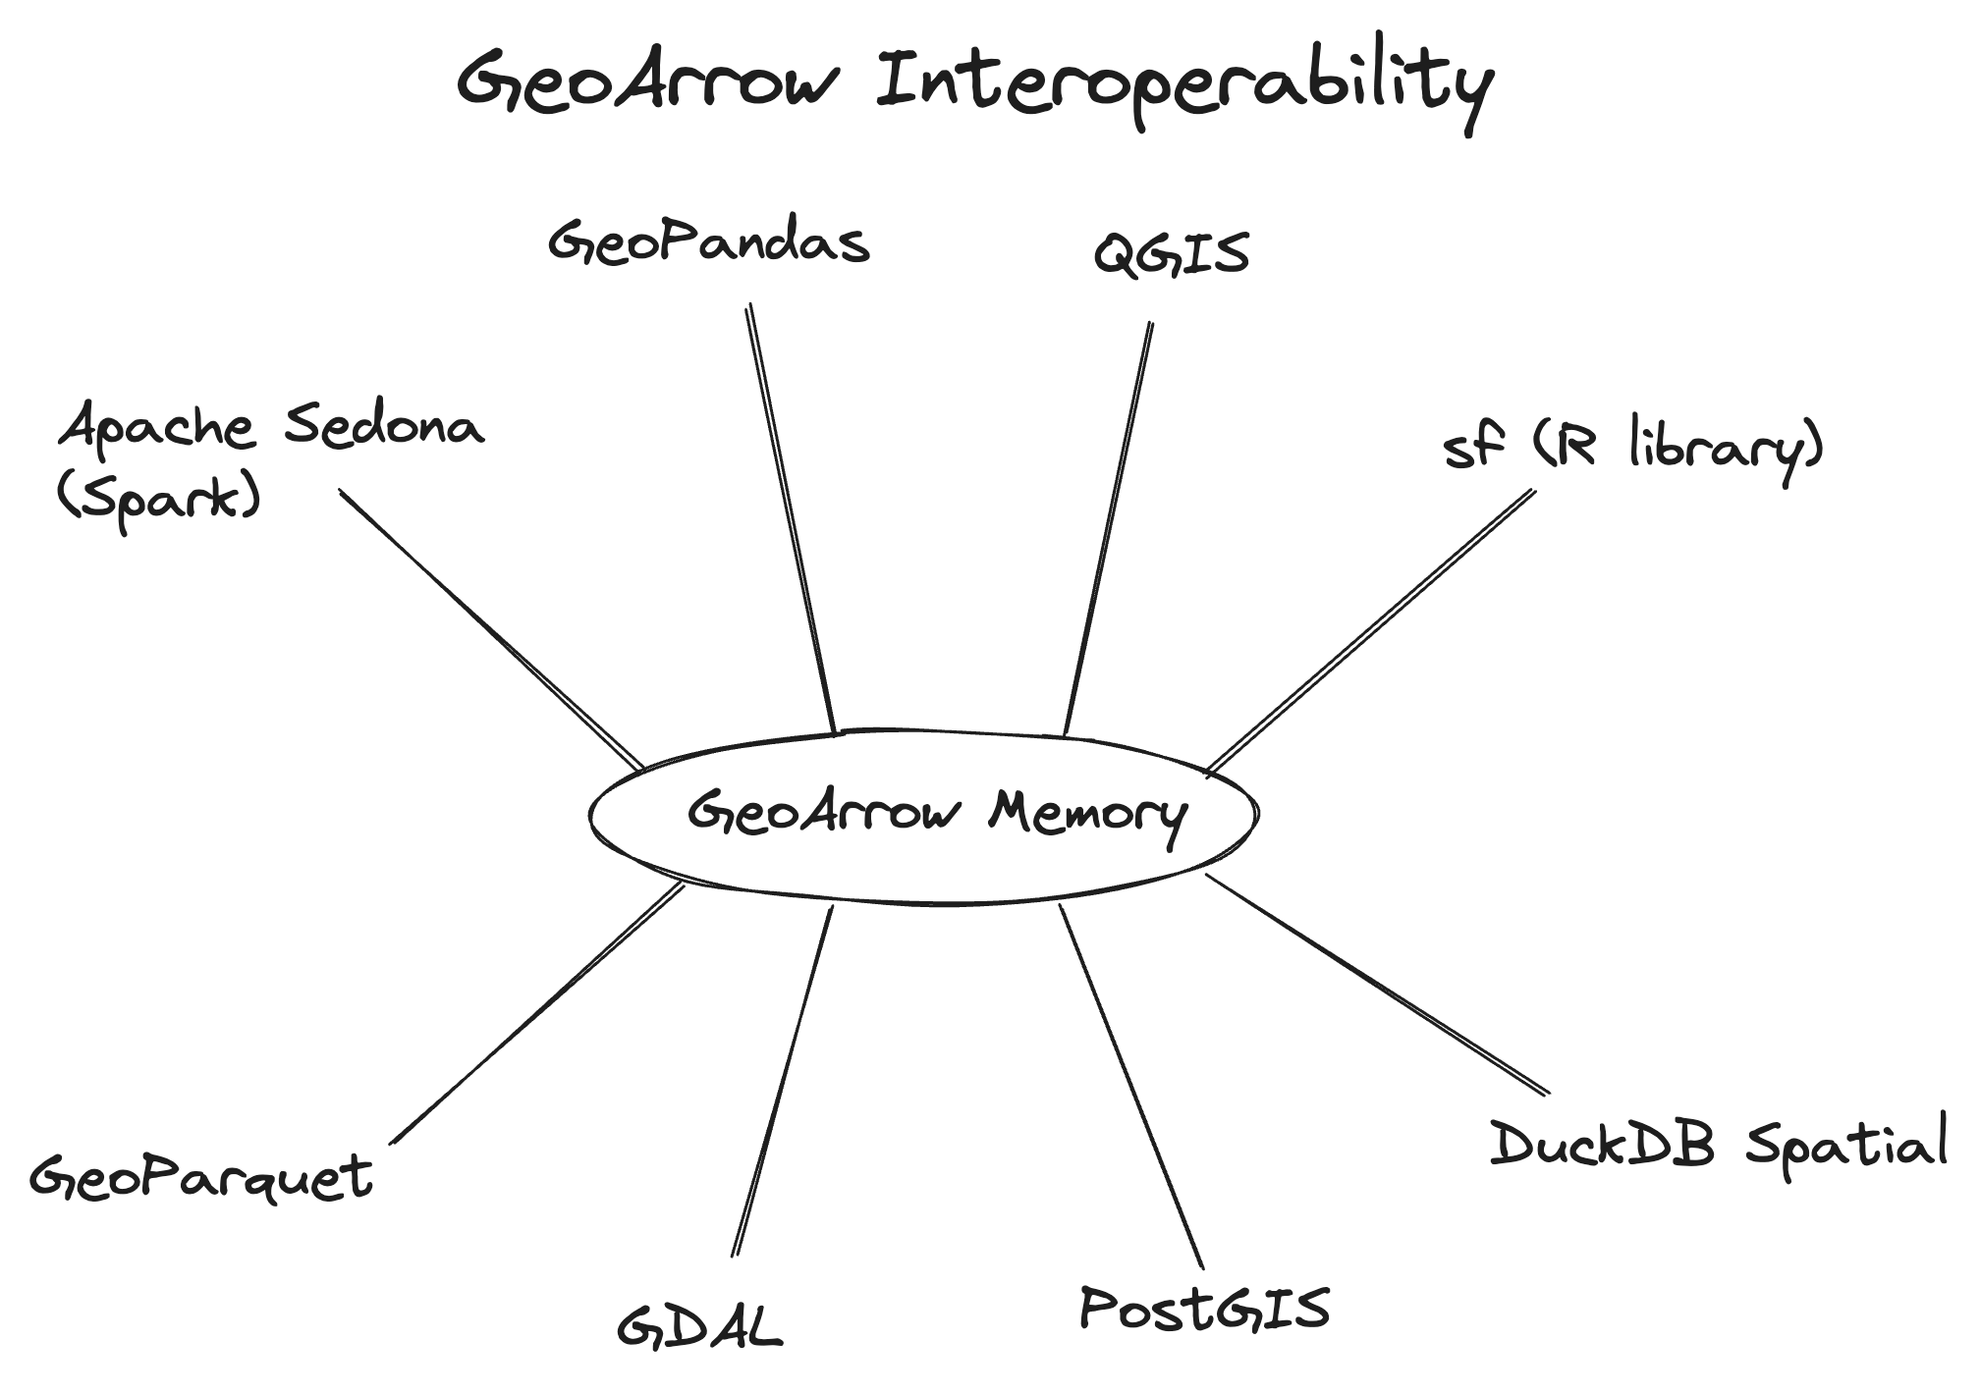
Enabling zero-copy data sharing for geospatial
GeoArrow (2020-)
Problem:
Expensive to copy & convert geospatial tabular data between systems
Python __geo_interface__ protocol exists but GeoJSON serialization is slow
Solution:
Protocol for language-independent zero-copy sharing of geospatial tabular data
Defines storage of vector geospatial data in Apache Arrow
Full Arrow type system available for attributes
Progress towards wide adoption:
GDAL RFC 86: Load any GDAL-supported vector format as a GeoArrow table.
Integrated into GeoPandas, DuckDB Spatial, cuSpatial
Loading a GeoParquet file gives you GeoArrow memory
Notes:
Motivating the talk in the reverse direction

Slide 63
Why deck.gl?
Uniquely-positioned to take advantage of GeoParquet and GeoArrow

Slide 64
Bandwidth is the browser's limiting factor for large data
Why deck.gl + GeoParquet?
Bandwidth is the browser's limiting factor for large data
Efficient compression: Parquet files are much smaller than comparable formats
Partitioning: Fetch only the requested columns/chunks of file
Spatial partitioning a future addition to GeoParquet spec
Cloud-native support: Fetch parts of the same files used for backend analytics
Notes:
Motivating the talk in the reverse direction

Slide 65
deck.gl’s binary API generally compatible with GeoArrow
Why deck.gl + GeoArrow?
ScatterplotLayer
Attributes
Buffer Layout
instancePositions
instanceRadius
instanceFillColors
instanceLineColors
instanceLineWidth
[x0, y0, z0, x1, y1, z1, …]
[r0, r1, …]
[R0, G0, B0, A0, R1, G1, B1, A1, …]
[R0, G0, B0, A0, R1, G1, B1, A1, …]
[w0, w1, …]
Slide from deck.gl Technical Deep Dive (Xiaoji Chen)

Slide 66
Enabling zero-copy data sharing for geospatial
Why deck.gl + GeoArrow?
Existing prioritization of large data rendering
Existing columnar binary data API
Investing in next-generation technologies like WebGPU
deck.gl’s binary API generally compatible with GeoArrow
ScatterplotLayer: GeoArrow PointArray
PathLayer: GeoArrow LineStringArray
PolygonLayer: GeoArrow PolygonArray
Notes:
Motivating the talk in the reverse direction

Slide 67
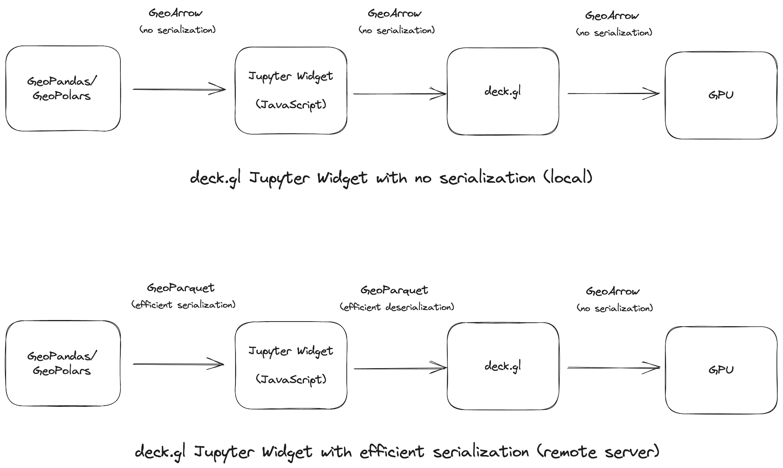
Python rendering with no serialization
Use Case: GeoArrow Jupyter Widget

Slide 68
Implementation status &
Future work

Slide 69
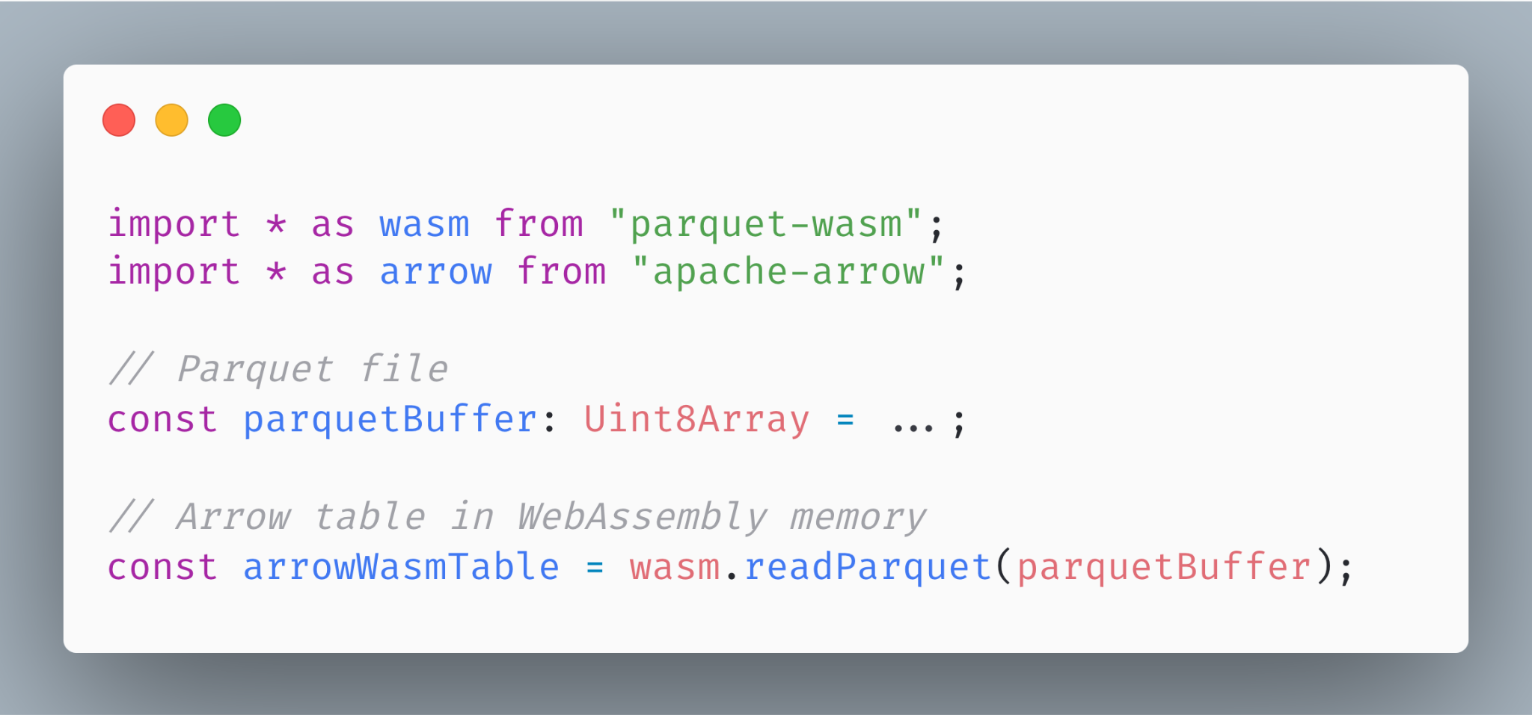
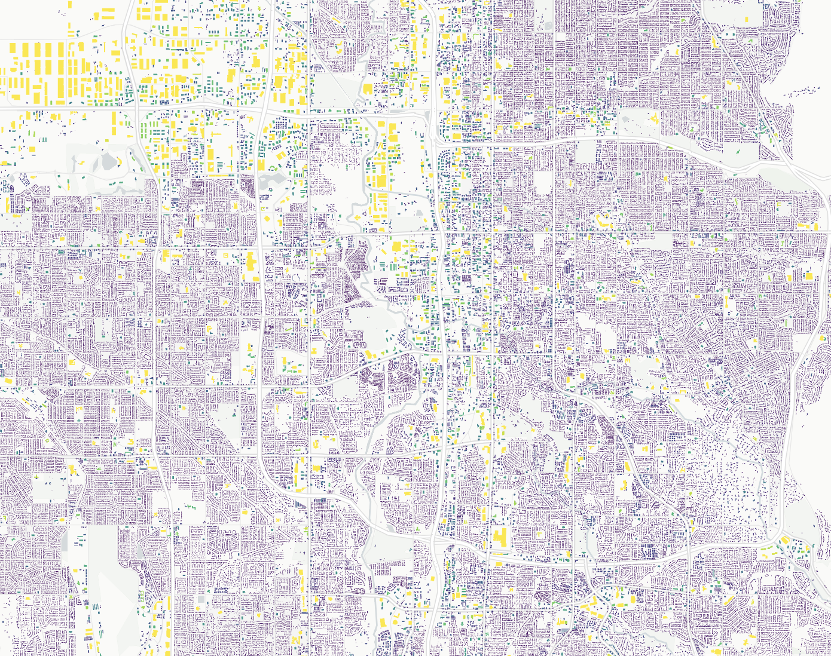
Fast, stable Parquet reading
parquet-wasm
WebAssembly (Rust) implementation of reading and writing Parquet
GeoParquet file with 1M buildings (7M coords) parses in 1.3 seconds (mac pro 14” 2023)
Wasm bundle size:
309kb (no compressions)
741kb (all compressions)
961kb (all compressions + async support)
https://observablehq.com/@kylebarron/prototyping-georust-geoarrow-in-webassembly
Notes:
Motivating the talk in the reverse direction

Slide 70
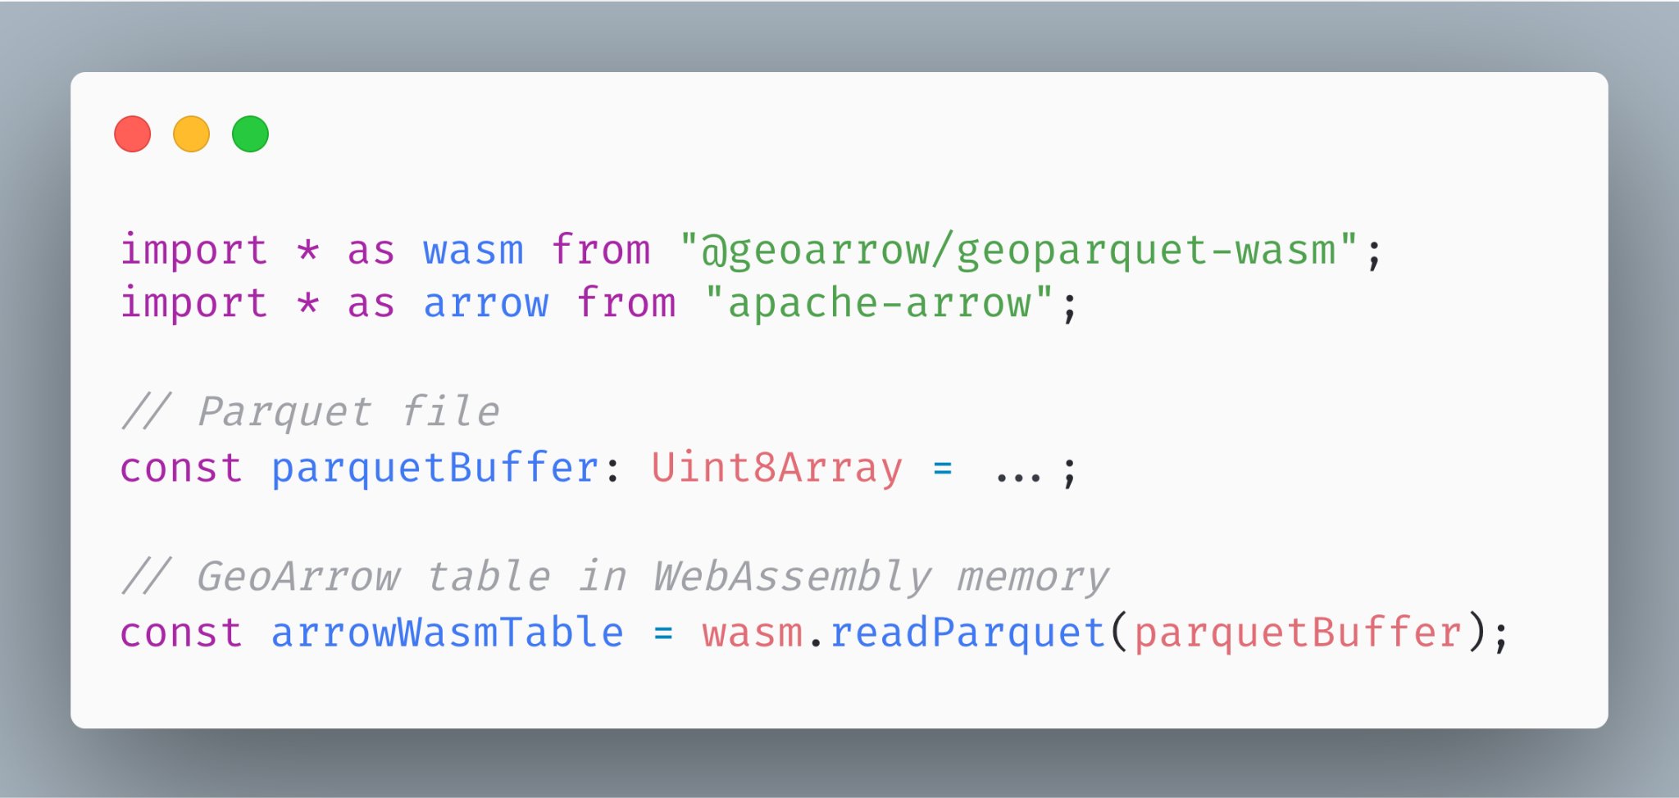
Fast, stable Parquet reading (with WKB parsing)
geoparquet-wasm
Adds Rust implementation of WKB parsing to parquet-wasm
Parses GeoParquet into GeoArrow
Published soon to NPM
Notes:
Motivating the talk in the reverse direction

Slide 71
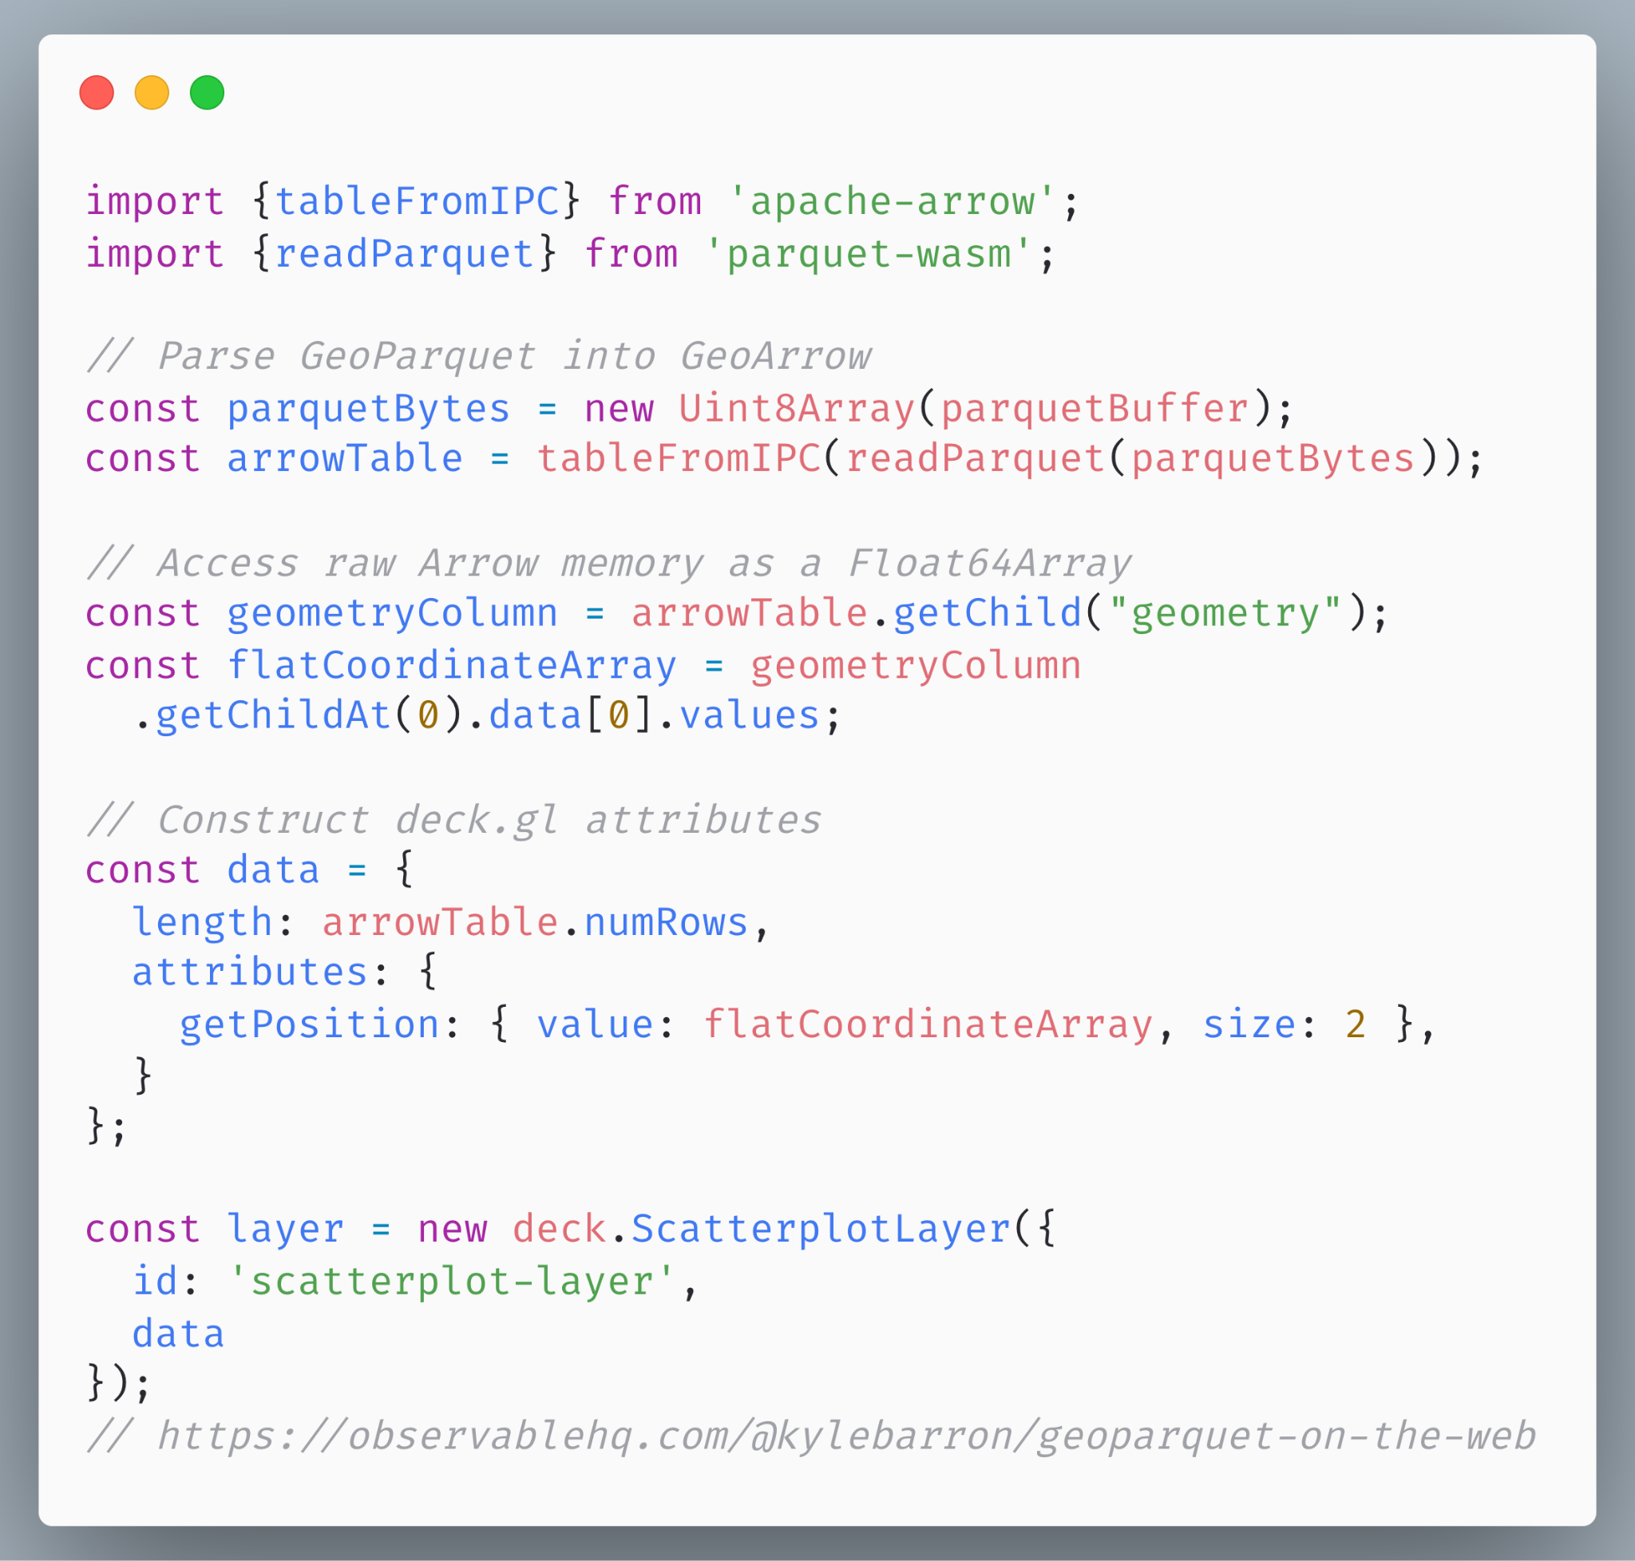
Using the binary API
deck.gl rendering
Pass GeoArrow coordinate buffers into the deck.gl binary API
Notes:
Motivating the talk in the reverse direction

Slide 72
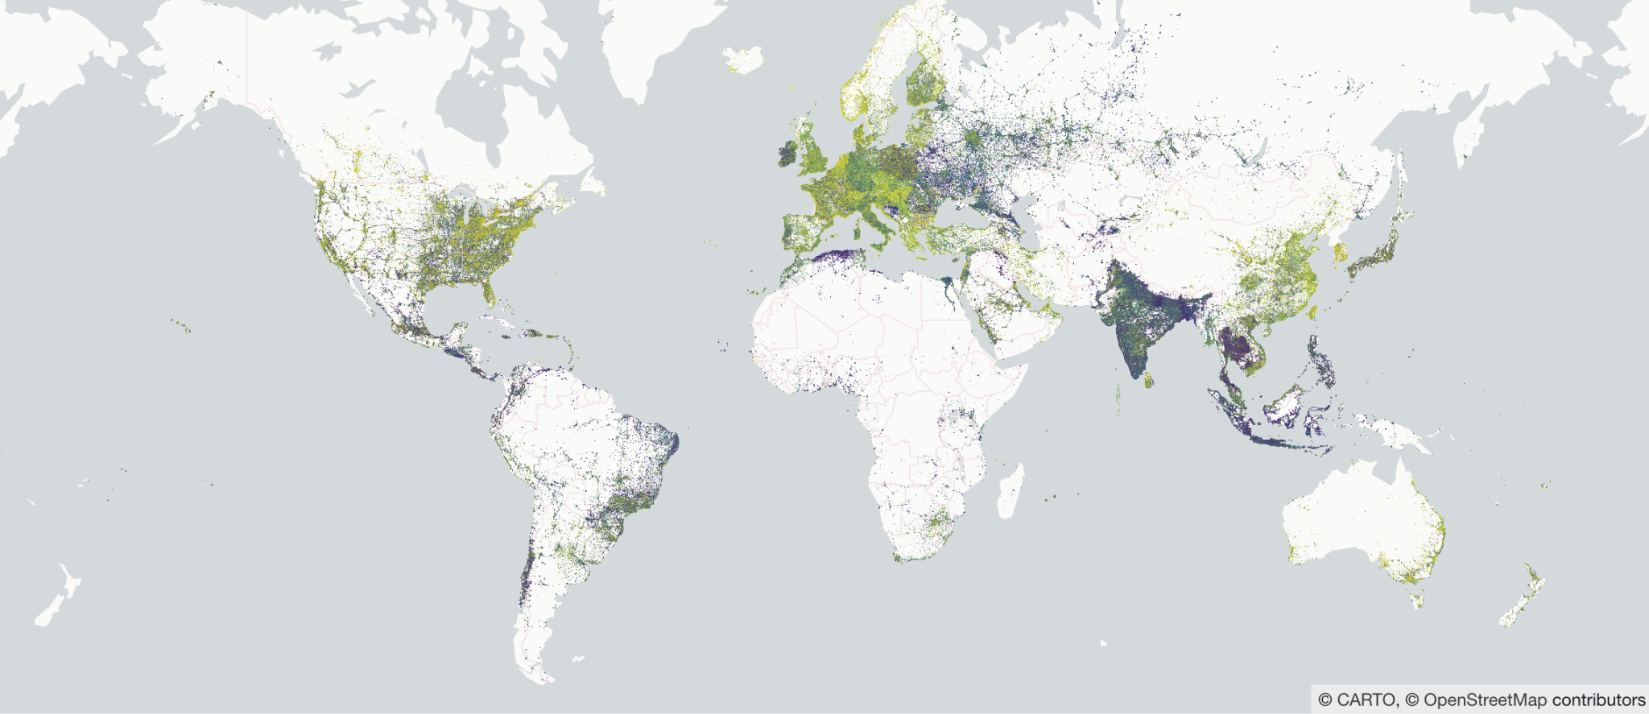
GeoParquet + GeoArrow + deck.gl
It’s really fast!
3.2 million points rendered in deck.gl
https://observablehq.com/@kylebarron/geoparquet-on-the-web
Notes:
Motivating the talk in the reverse direction

Slide 73
GeoArrowLayer
Future work: Usability
Today: requires manually passing buffers into binary API
Tomorrow: GeoArrowLayer
Accept Arrow JS Table or similar; render sub layers automatically
Renders one deck.gl sub layer for each internal chunk
Better integration with picking, styling
Notes:
Motivating the talk in the reverse direction

Slide 74
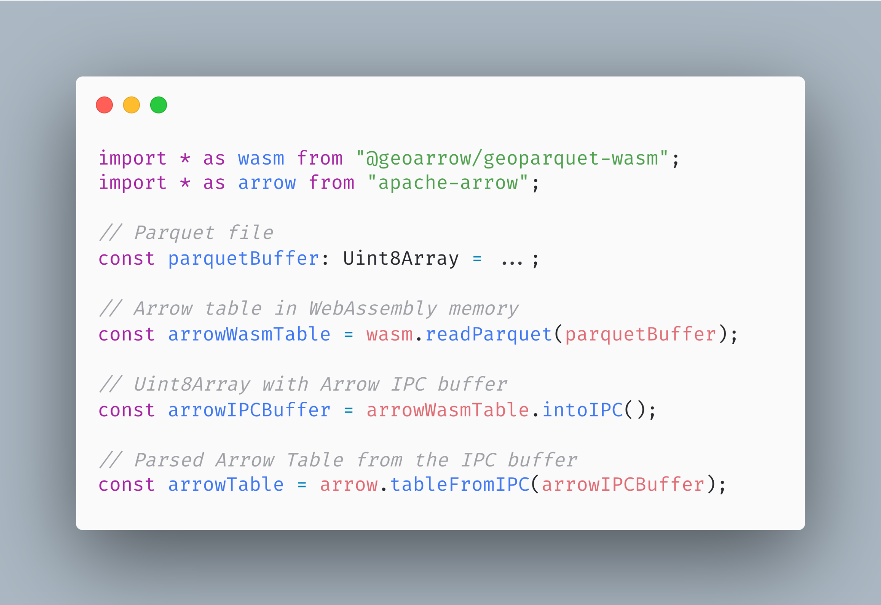
Future work: Performance
Today: copying Arrow from Wasm
Parse Parquet into an Arrow table in WebAssembly memory
Copy the table into Arrow IPC format in WebAssembly memory.
Copy the buffer from WebAssembly memory to JS memory
Parse it on the JS side into an Arrow Table
Step 2 requires materializing a single buffer, pushing peak memory utilization very high.
Notes:
https://carbon.now.sh/aX34XLgwDLy7UREwbWyQ

Slide 75
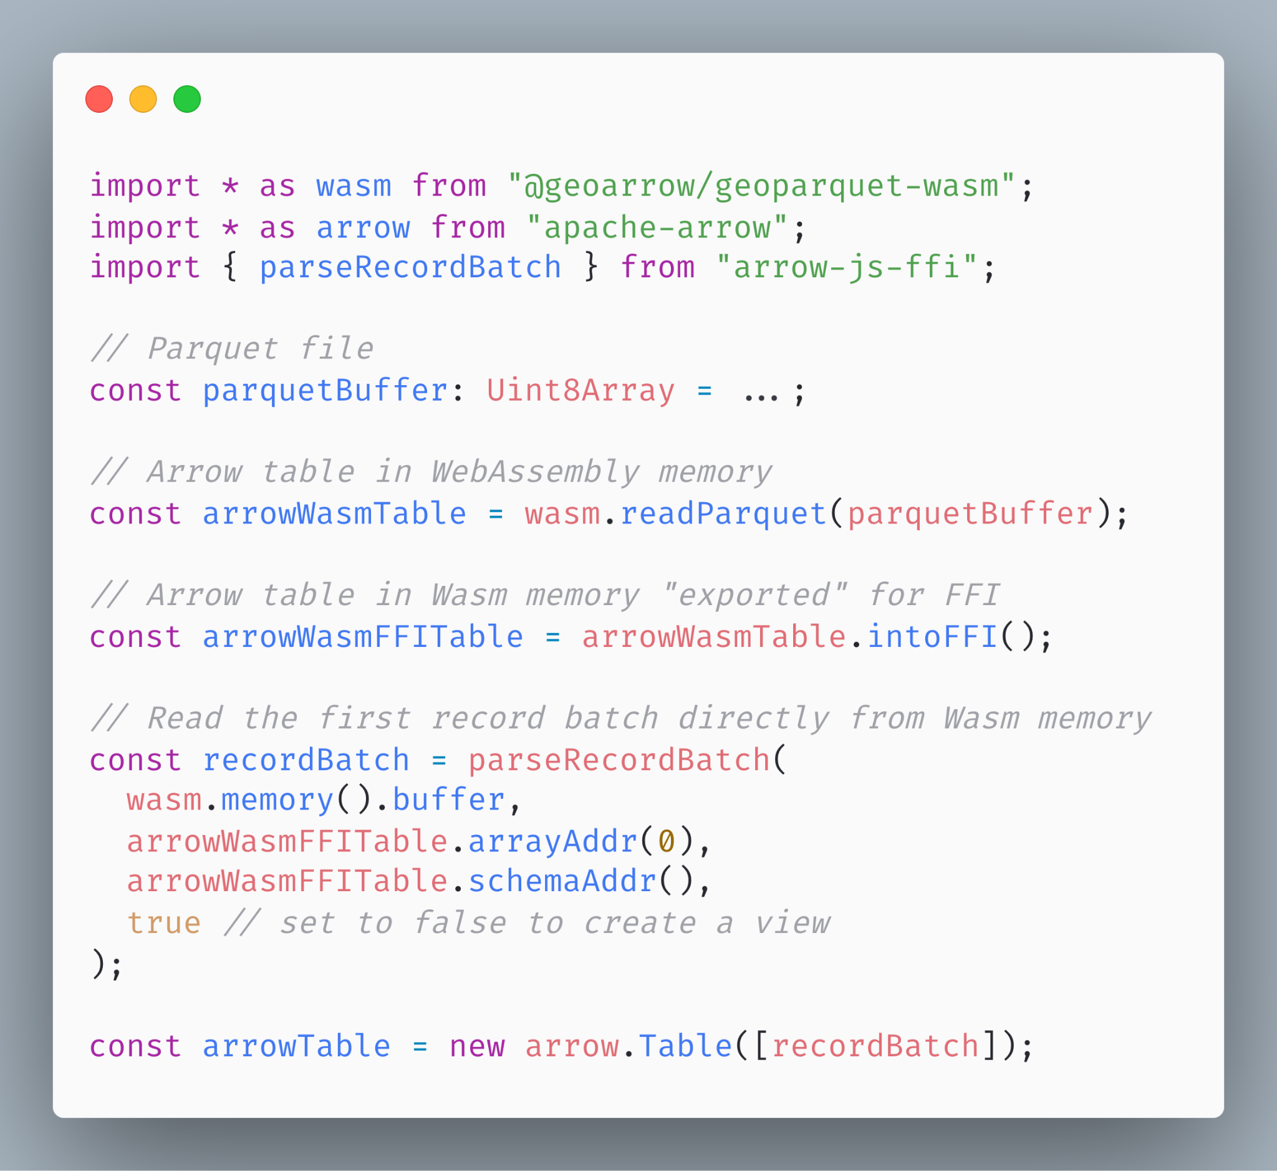
Future work: Performance
Tomorrow: no serialization
Every Arrow implementation has exact same memory layout: no serialization needed
Parse Parquet into an Arrow table in WebAssembly memory
Copy the table into Arrow IPC format in WebAssembly memory.
Copy or view the table directly from WebAssembly memory
Parse it on the JS side into an Arrow Table
Reduces peak memory pressure in Wasm by almost half.
Also possible in some cases to copy directly from Wasm to the GPU
https://github.com/kylebarron/arrow-js-ffi
Notes:
https://carbon.now.sh/aX34XLgwDLy7UREwbWyQ
This means that when the GeoArrow memory format coincides with the binary format deck.gl knows how to interpret, we can render geometries copying directly from WebAssembly to the GPU!.
This is error prone and should be used very carefully (e.g. if the Wasm memory space grows, your views get broken), so I recommend most users to copy these arrays into JS. But this is still much more memory efficient than constructing an IPC buffer.

Slide 76
Enabling zero-copy data sharing for geospatial
Future work: Bundle size
I’ve started to explore library for very minimal Arrow array definitions
Complementary to & ABI-compatible with Arrow JS, useful for getting data in and out of Wasm
A GeoArrowLayer could possibly avoid hard dependency on Arrow JS
Notes:
Motivating the talk in the reverse direction

Slide 77
kylebarron
kylebarron2
kylebarrongeo

